Slide 1
User Manual for Tuya Smart V3.18.1

Slide 2
Index
4、Device Control -----------------------------------53
4.1 Device Control-Individual Control----------------54
Device Control-Device Management-------------55
Device Control-Device Sharing--------------------56
4.2 Device Control-Group Control---------------------57
5、Smart-Automation--------------------------------59 5.1 Smart-Automation-Add Condition---------------66
Smart-Automation-Add Task----------------------67
Smart-Automation-Effective Period --------------68
Smart-Automation-Examples----------------------69
Smart-Automation-Push messages support
multiple selection-----------------70
5.2 Smart-Scenario-------------------------------------71
Smart-Scene-Zigbee gateway linkage data backup
and recovery---------------------------------------73
5.3 Smart-Add/Edit/Delete ----------------------------75
Smart-Scene logs-----------------------------------78
5.4 Smart-Scenario Execuation in LAN ----------------79
6、My Home------------------------------------------80
7、Me”-----------------------------------------------81
7.1 “Me”-Watch-------------------------------------82
7.2 “Me”-App Notification Settings----------------83
7.3 “Me”-Messege Center--------------------------86
7.4 “Me”-FAQ & Feedback-------------------------89
7.5 “Me”-More Services-----------------------------90
7.6 “Me”-About -------------------------------------92
8、Personal Center----------------------------------93
8.1 Account &Security-Account Deactivation--------94
8.2 Personal Center-Pattern Lock---------------------95
1、App Download-------------------------------------------------------------3
2、Register/Log in/Forgot Password----------------------------------------4
3、Use App---------------------------------------------------------------------9 3.1 Home/Members Management---------------------------------------------10
3.2 Voice Assistant--------------------------------------------------------------15
3.3 Environment Information---------------------------------------------------18
3.4 Add Devices-----------------------------------------------------------------19
3.4.1 Add Manually-Wi-Fi Device-EZ Mode----------------------------------21
Add Manually-Wi-Fi Device-AP Mode----------------------------------22
Add Manually-Wi-Fi Device-Enter Wi-Fi Password---------------------23
Add Manually-Wi-Fi Device-Network Configuration-------------------24
Add Manually-Wi-fi bluetooth dual mode network--------------------28
3.4.2 Add Manually-Zigbee Device-------------------------------------------35
3.4.3 Add Manually-IPC Device-Wired Network Configuration-------------38
3.4.4 Search Device------------------------------------------------------------40
Search Device-Request for Permission---------------------------------41
Search Device-EZ mode that Supports Add Devices Manually -------43
3.4.5 can to Pair Devices ：Scan QR code in NB Products or Enter Code---44
Added the distribution method of scanning code
distribution network----------------------45
3.5 Device List-----------------------------------------------------------------46
3.5.1 Device management----------------------------------------------------47
Room Sequence--------------------------------------------------------48
3.5.2 Device/Room List-------------------------------------------------------49
3.5.3 Quick Actions for Common Functions---------------------------------50

Slide 3
NO.1
Download App
You can download the App by searching “Tuya Smart”in mobile app stores or scanning the following QR code.

Slide 4
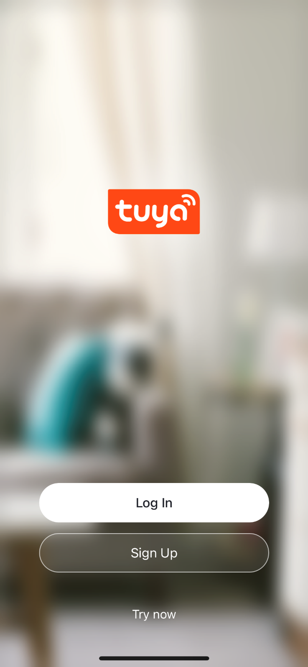
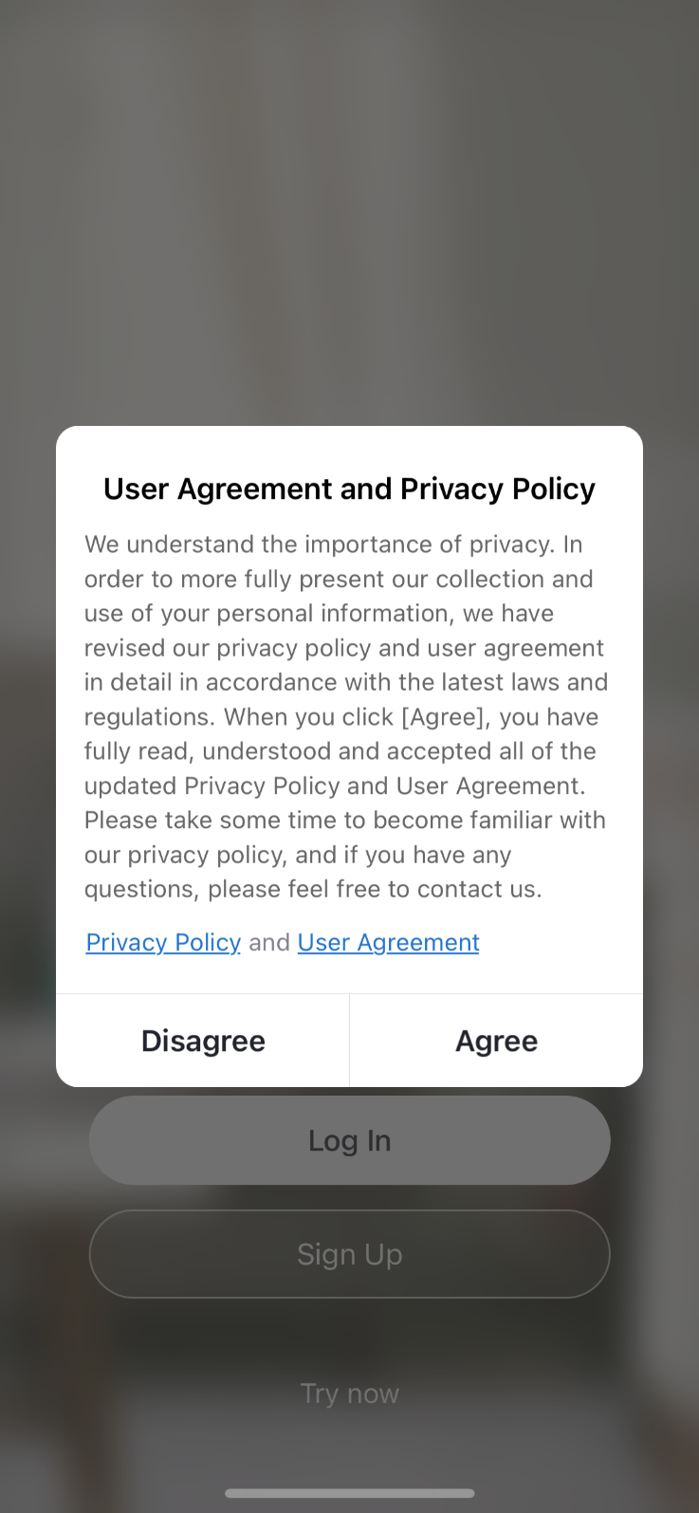
NO.2
Register/Log in/Forgot Password
Register
1.Click “Sign Up”and read the Privacy Policy after it pops up. Click “Agree” and enter the registeration page.

Slide 5
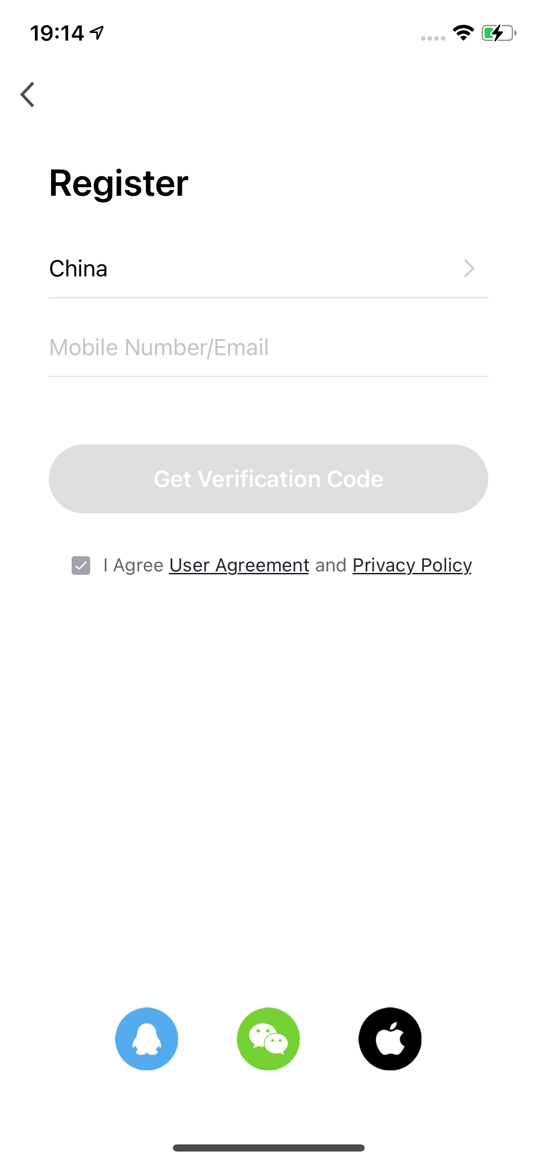
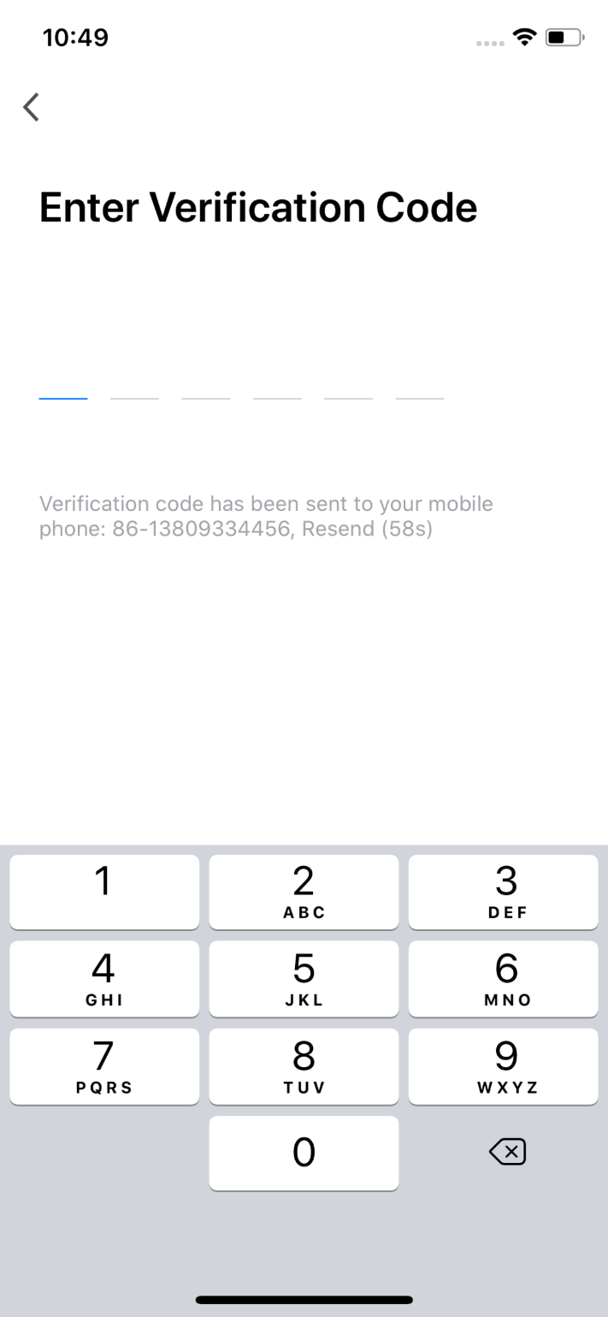
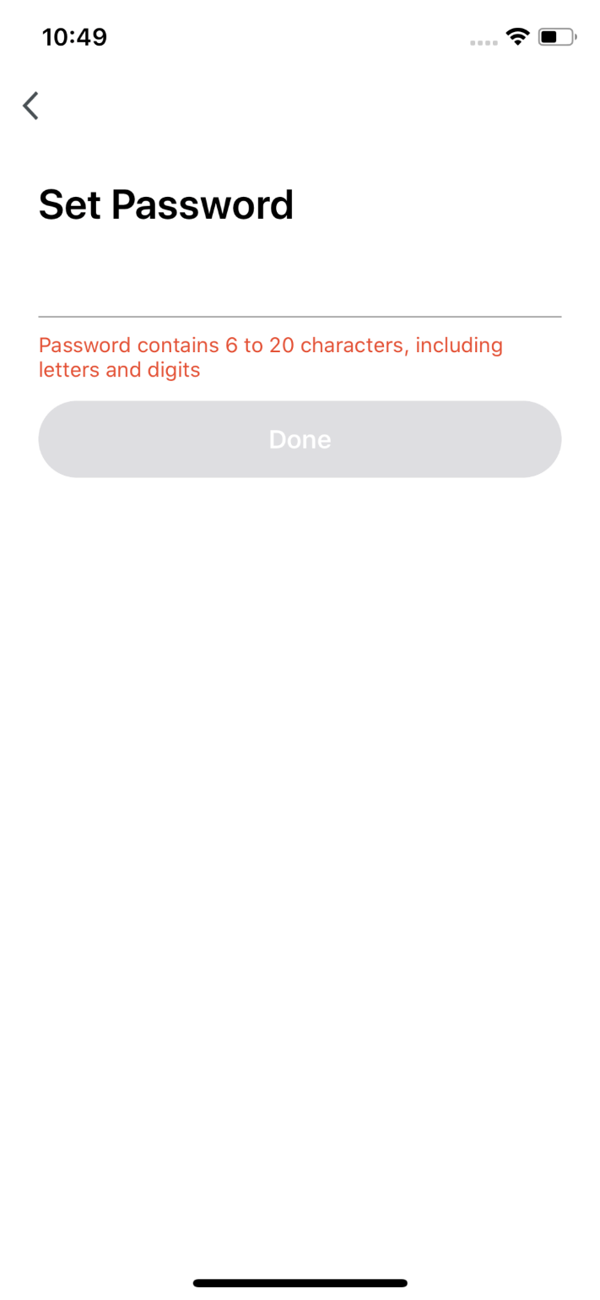
NO.2
Register/Log in/Forgot Password
2.You can use email or mobile number as your account to register. The country/region of the APP will be the same as the phone's. You can also change it by yourself when registering.（You cannot change the country/region after the registeration). Enter mobile number/email and click”Get Verification Code”；
3.Enter the verification code and turn to the password setting page. Set your password as required and click “Done”.

Slide 6
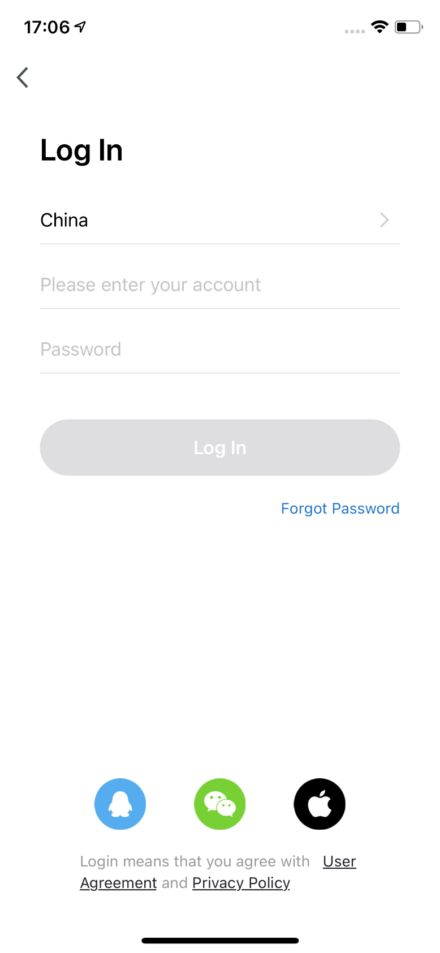
NO.2
Register/Log in/Forgot Password
Log in
If you already have an account,choose “Register with Existing Account”and enter the log in page.
1.The system will automatically locate the current country/region you are in. Or you can choose the country/region by yourself.
2.Enter mobile number/ email and password.
Thirdy-party Social Account Log in
If you have downloaded Wechat or QQ on your phone, you can click the Wechat/QQ icon in the log in page. You can log in using your wechat/QQ account after authorizing it.If you are using iPhone,you can also log in with Apple ID.

Slide 7
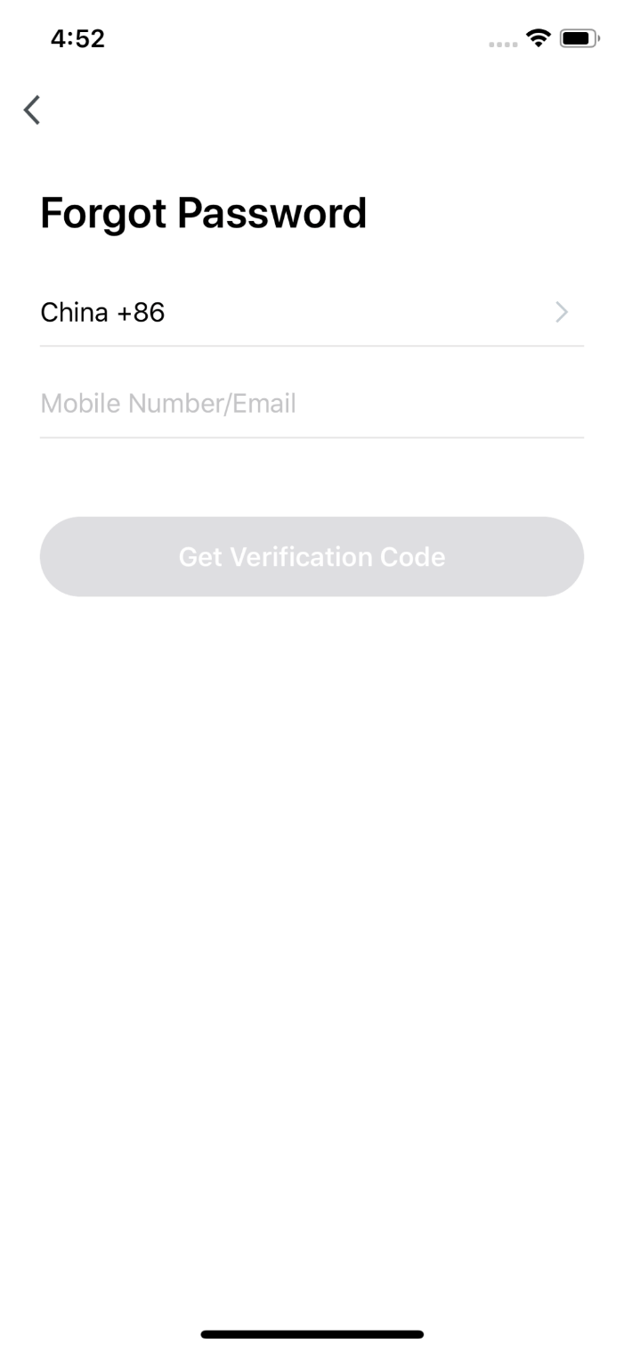
NO.2
Register/Log in/Forgot Password
Forgot Password
If you forget your password, you can follow the procedures and retreive it.
1. Click“Forgot Password”；
2. The system will automatically locate the current country/region you are in. You can also choose the country/region by yourself.
3. Enter the mobile number/email that you use to register and click “Get Verification Code”.

Slide 8
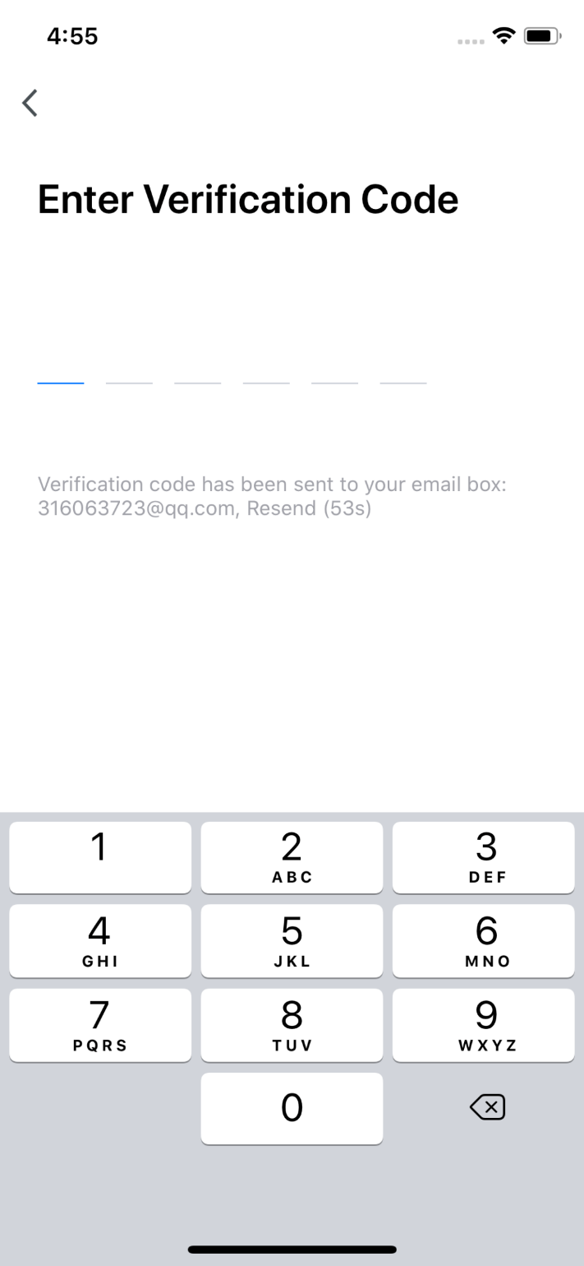
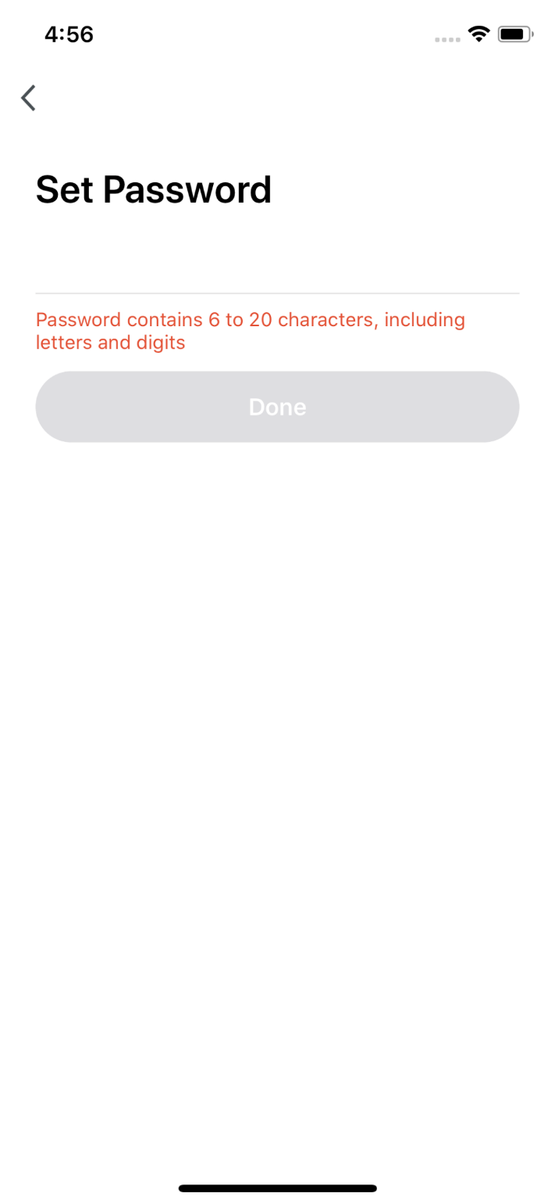
NO.2
Register/Log in/Forgot Password
4. Enter the verification code you receive in SMS or email；
5. Enter your new password, click“Done”to reset the password. The app will automatically log in using your new password.
6. For security concerns, the APP will detect risks in the phone system when logging in. If it detects root or jailbreaking risk, it will pop up “Security Reminder”and you can choose whether to exit the app or not.（If you do not choose anything, the app will exit automatically.）

Slide 9
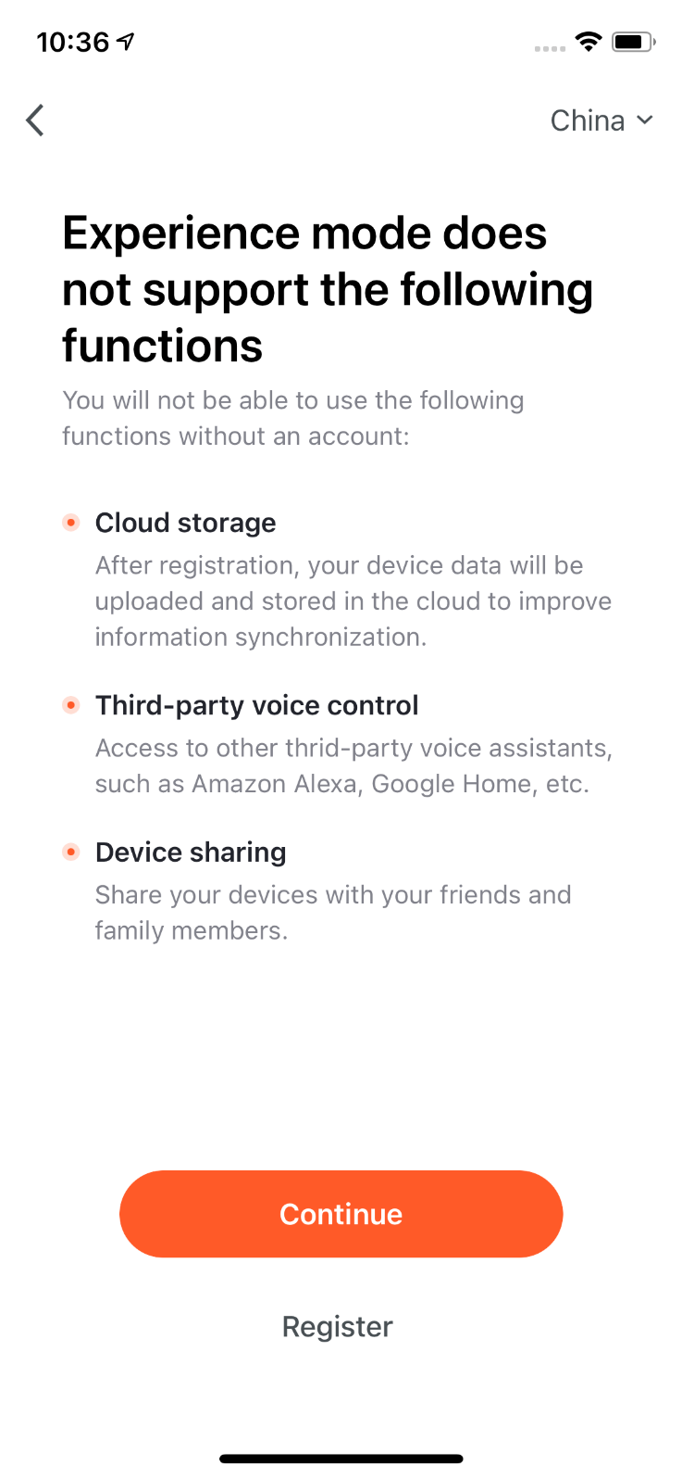
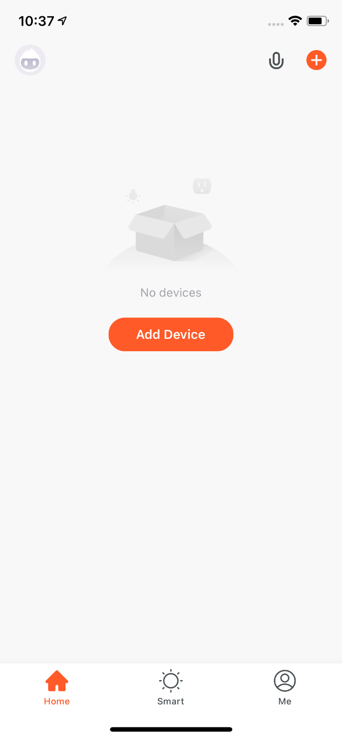
NO.2
Register/Log in/Forgot Password
Experience Mode
1. Click “Try now”, a prompt page will appear.
2. In Experience mode，the following functions are not be supported：Cloud storage, Third-party voice control, and Device sharing.
3. Click “Continue” to accept the experience mode notices，and you will enter the home page.

Slide 10
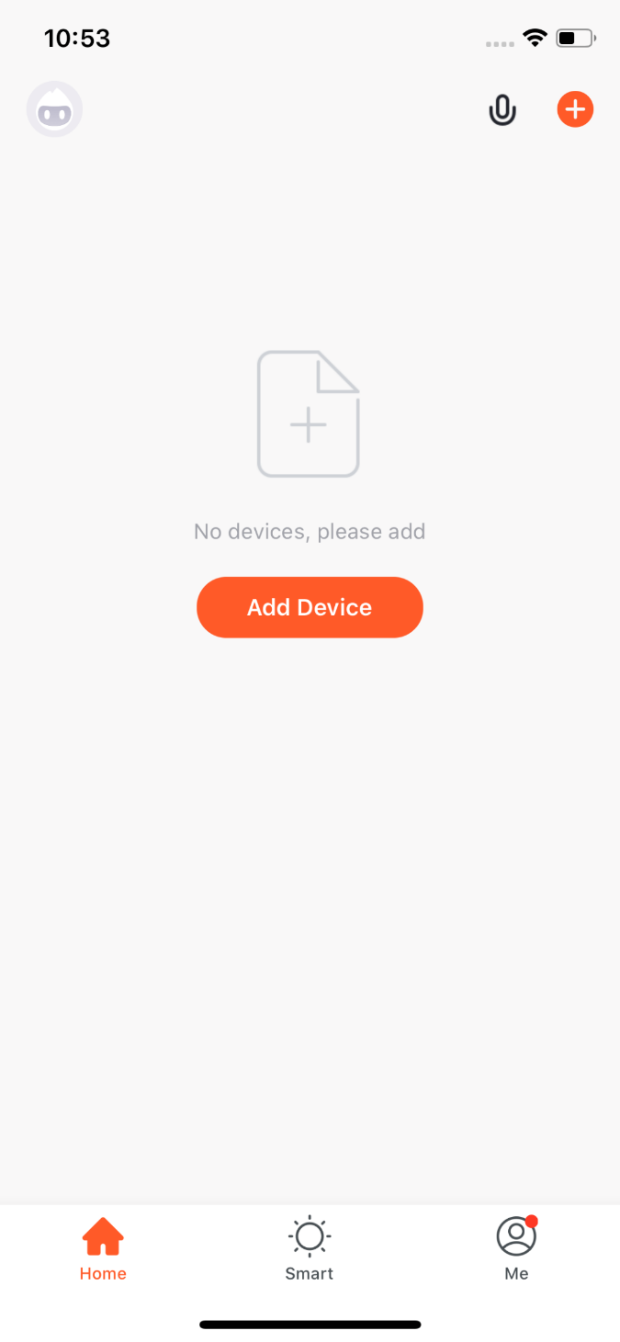
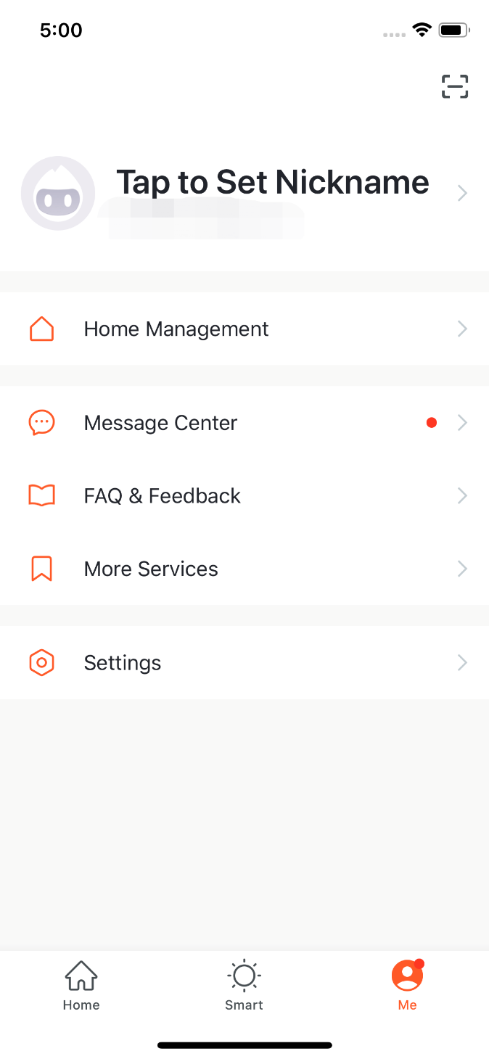
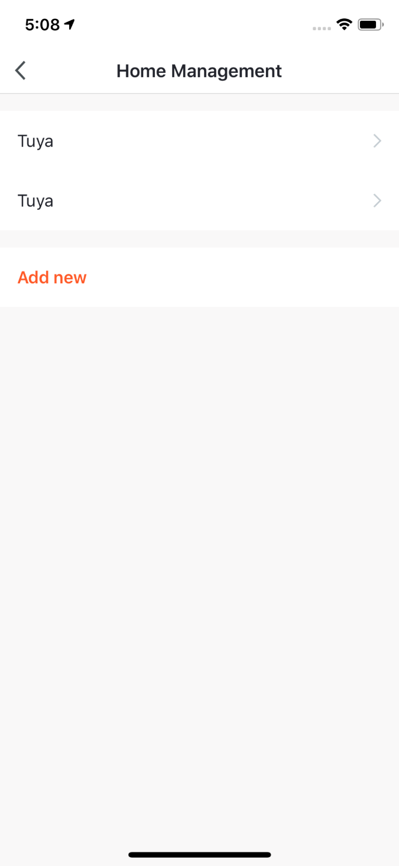
NO.3
Use APP
1. When new users enter the app, they will see the home page where the devices are listed. The user profile will be shown in the top left corner. There will be room and environment information before you complete the home information.
2. Click “Me”in the lower right corner and choose “Home Management”to enter the page.
3. If you are a new user, when you click“Home Management”, the app will directly turn to the page where you can add new homes and edit home information.
4. If you have already added homes before, you can click “Add new”to enter the page.

Slide 11
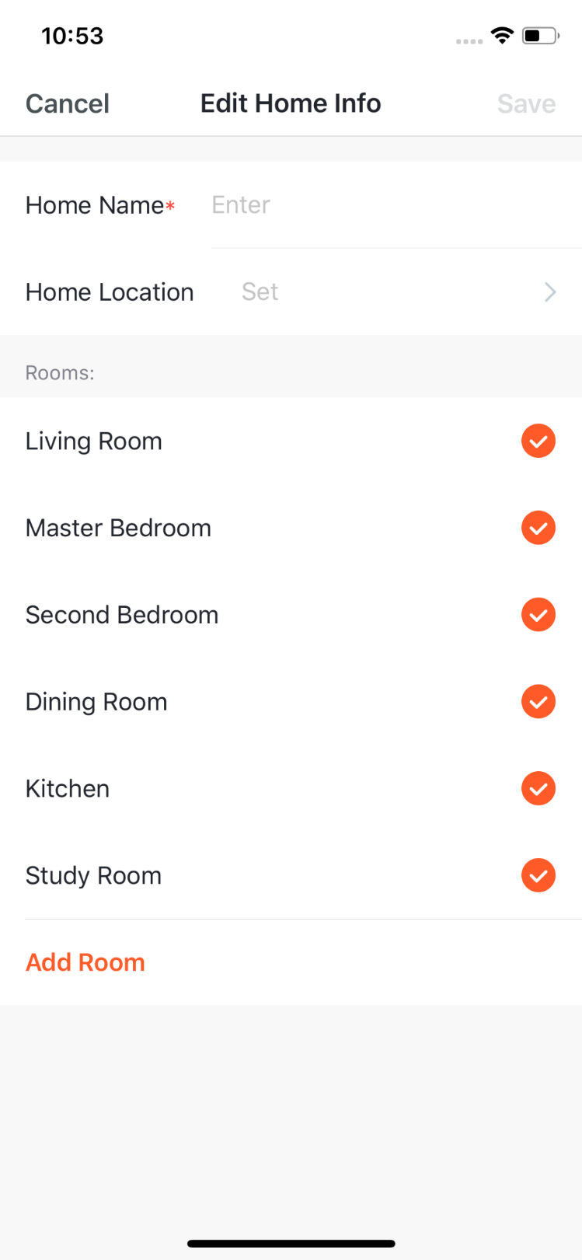
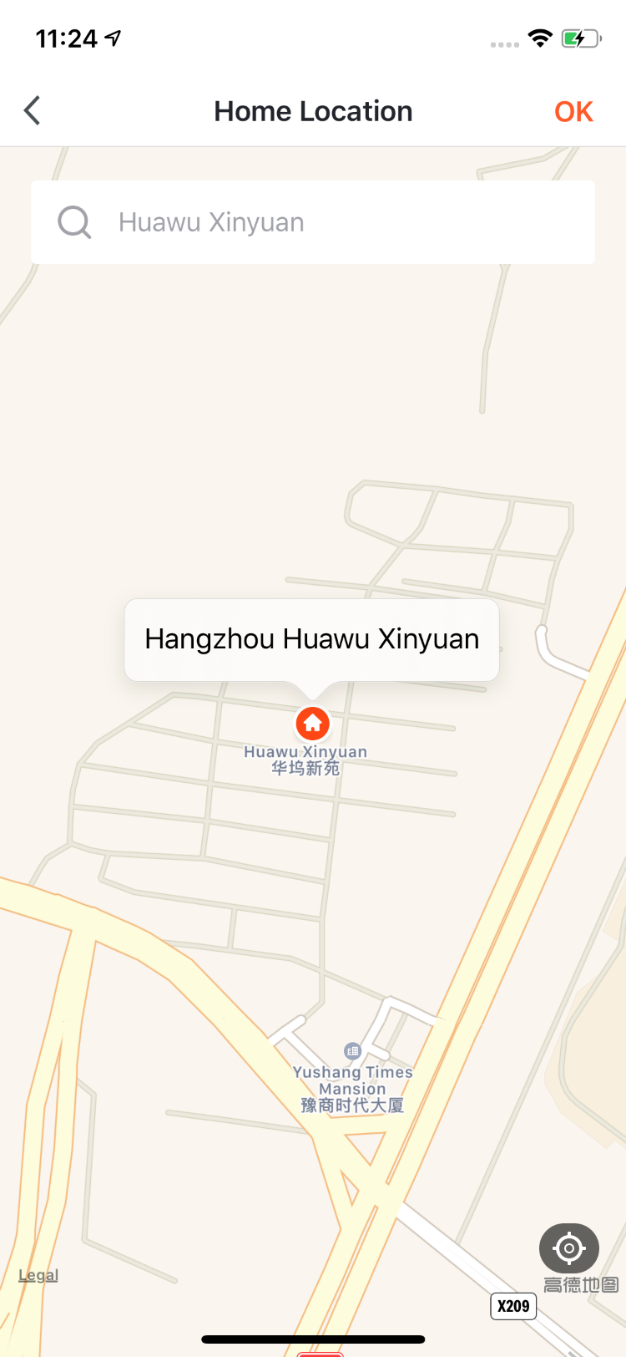
NO.3.1
Home/Member Management
5.You can change the“Home Name”as you like.（25 characters maximum）；
6. “Home Location”will change with your phone location. You can also change the home location by setting the home coordinate. Click “Confirm”after making sure the location is correct..

Slide 12
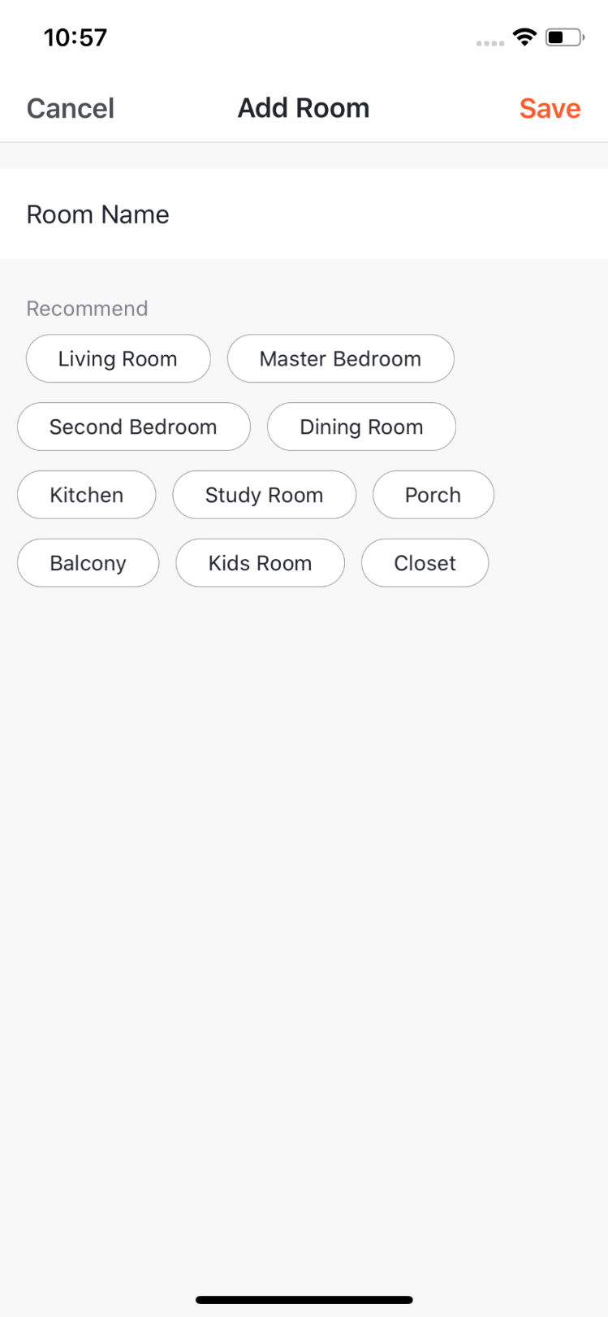
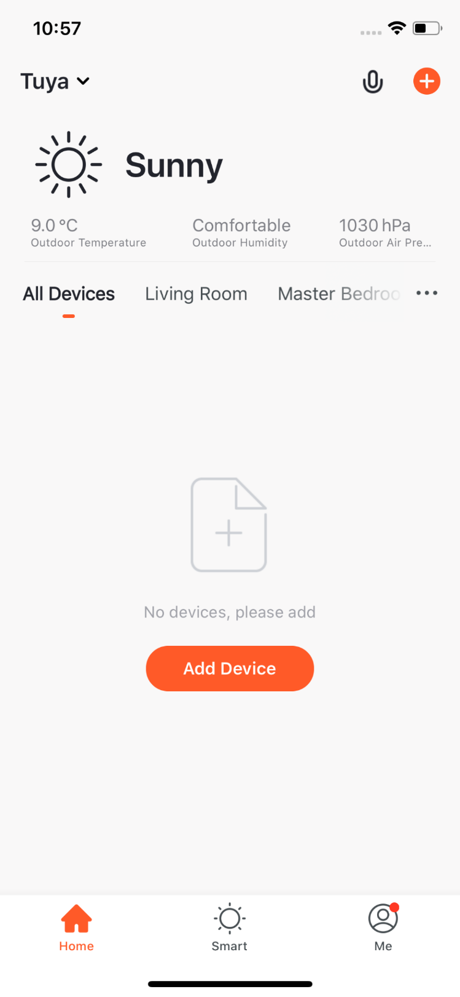
NO.3.1
Home/Member Management
7. You can choose the room name given by the system. Or click “Add Room”to customize the room names（25 characters maximum).
8. After you complete the home information and turn to the home page, you will see information such as weather,humidity level and room names. If you have added more than one homes, click the button on the upper left to switch and manage other homes.

Slide 13
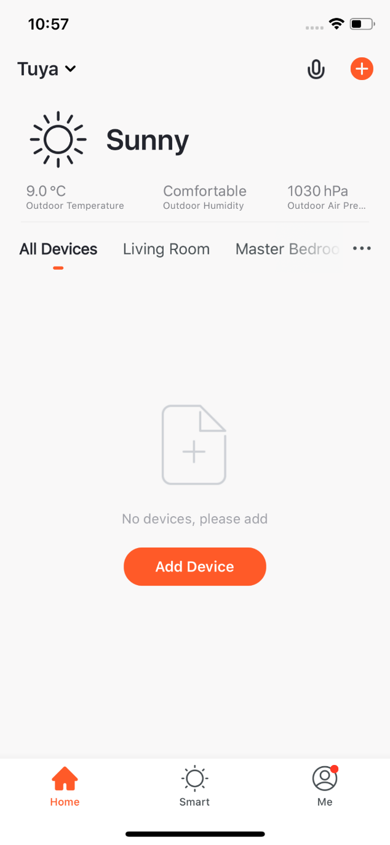
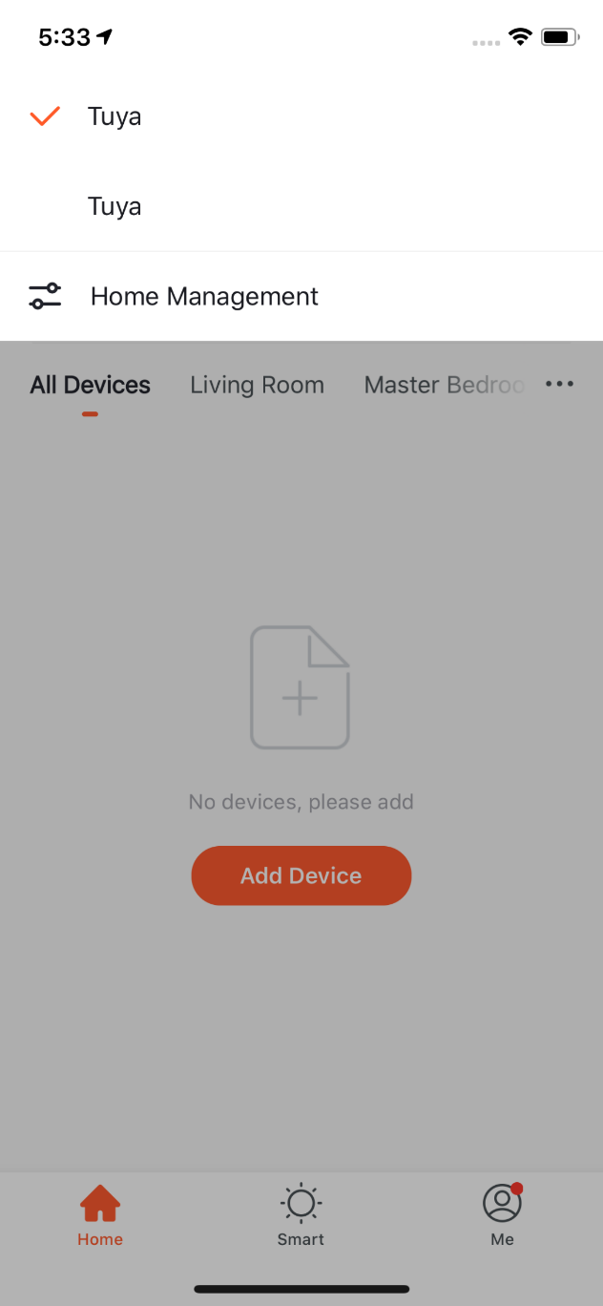
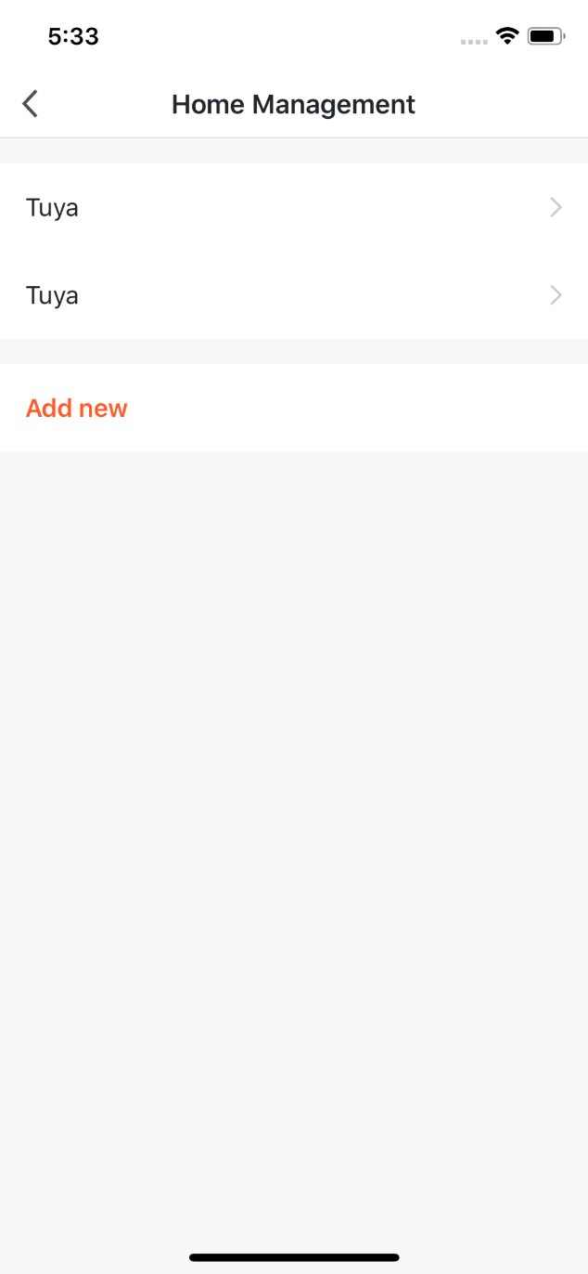
NO.3.1
Home/Member Management
9. In “Home”page, you can click the button in the upper left to switch to other homes.
10. In “Home Management”,you can edit the existing homes and add new homes. An account can control multiple homes, and the smart devices in different homes will not interefere with each other when using.

Slide 14
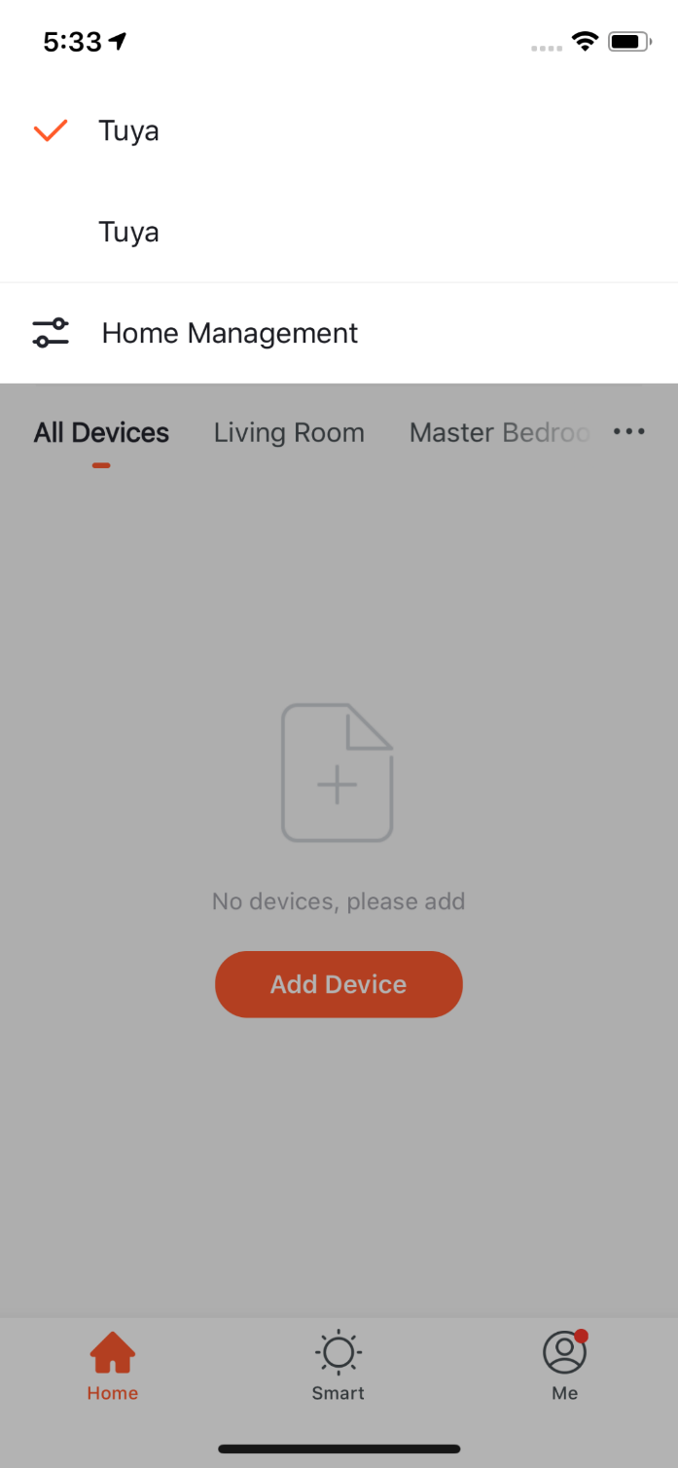
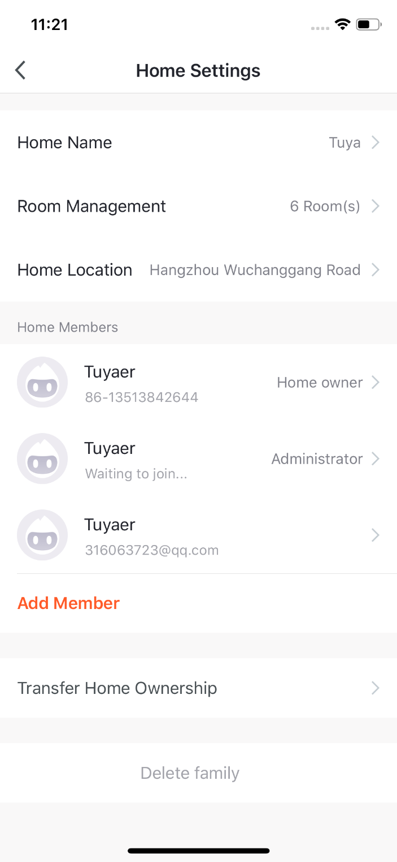
NO.3.1
Home/Member Management
11. Click“Tuya”to enter Home Settings page, as shown in the pictures
Edit the rooms in homes and manage the deivces in the rooms.
After the invitation is sent, it will show “waiting to join ”before the user agree to join.
Home owner has the highest access. It can manage all the devices, rooms, smarts, administrators and members in the home.
Administrators can click here to invite other people to join this home.
Administrator can manage devices, rooms, smarts and members.
Member can only use devices and smarts.

Slide 15
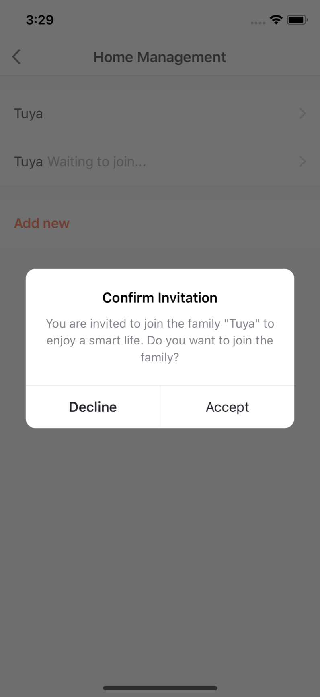
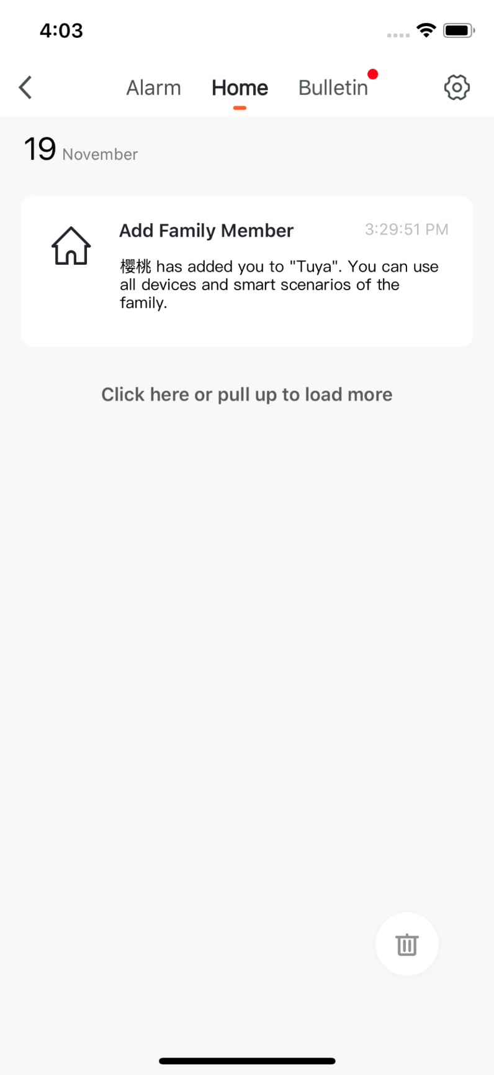
NO.3.1
Home/Member Management
12. If you are invited to a home, you will receive pop-up notification in the APP. You can choose decline or accept. You will also receive notification in the messege center.

Slide 16
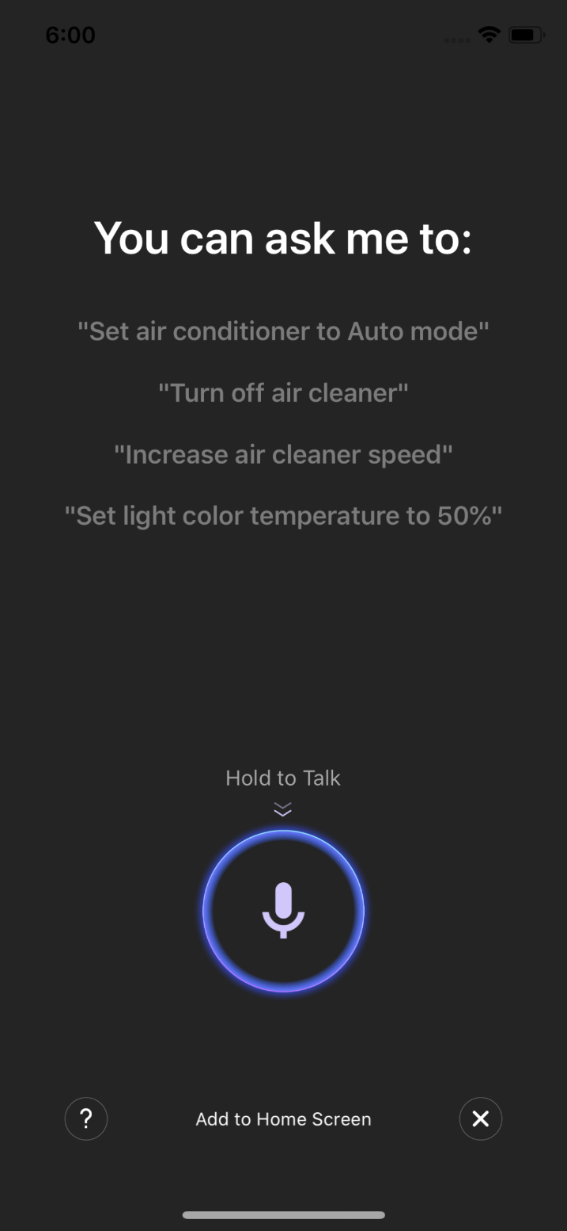
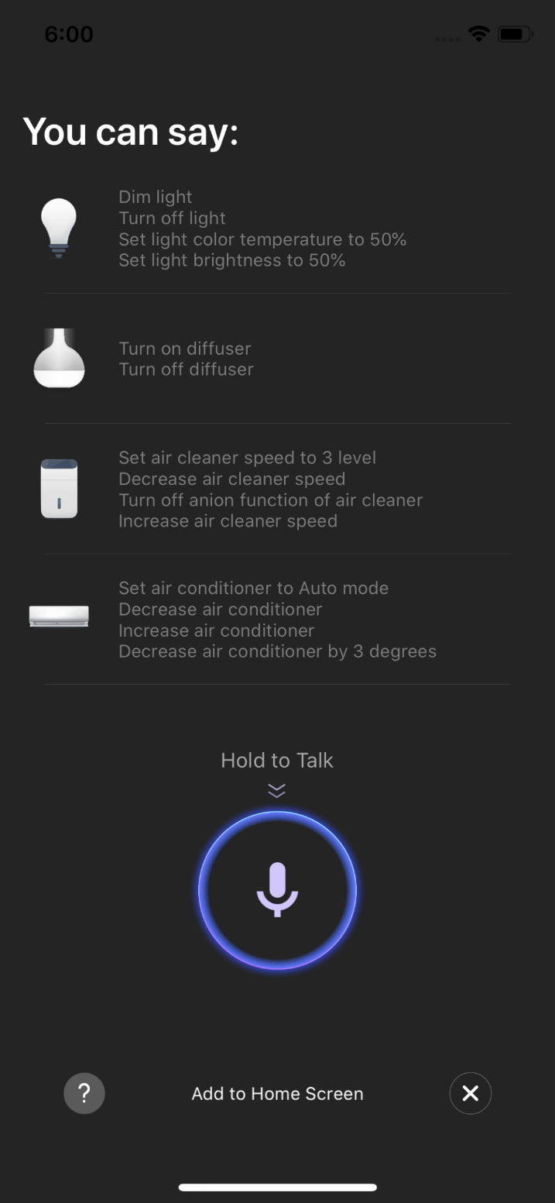
NO.3.2
Voice Assistant
Click the mic icon in the top right corner and enter the voice assistant page.
If you do not know how to use it, you can click “?” on the bottom left and check for instruction.

Slide 17
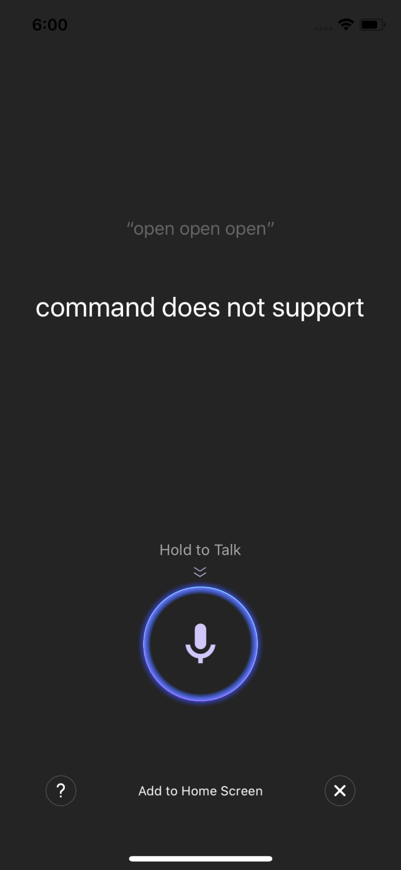
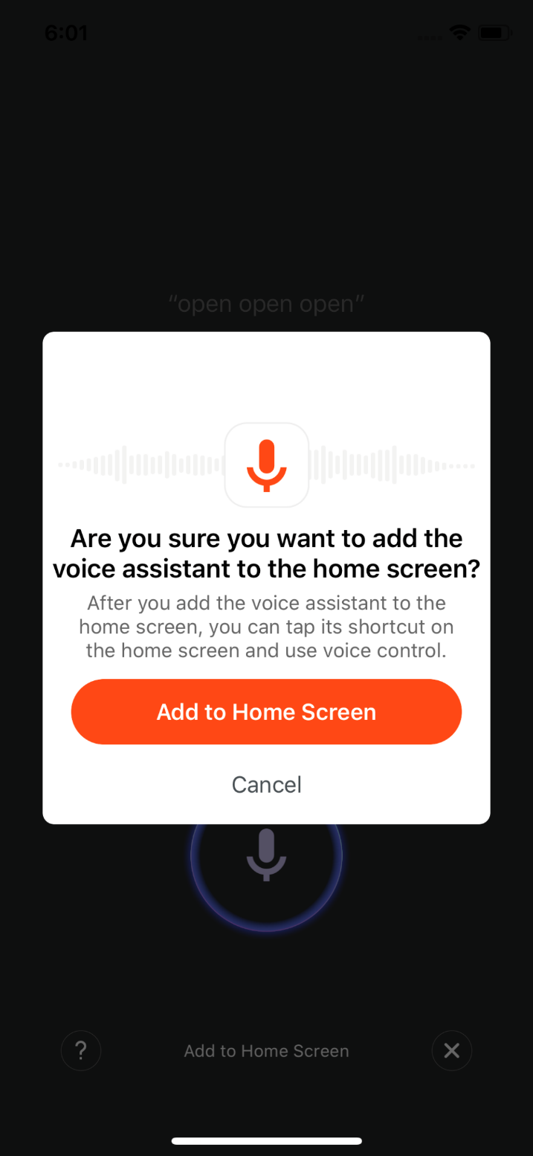
NO.3.2
Voice Assistant
3. You can give command to the voice assistant according to the instruction. When giving instruction, please press the mic icon.
4. If you want to do this in a more convenient way, you can click “Add to Home Screen” and create shortcut in the phone home page.

Slide 18
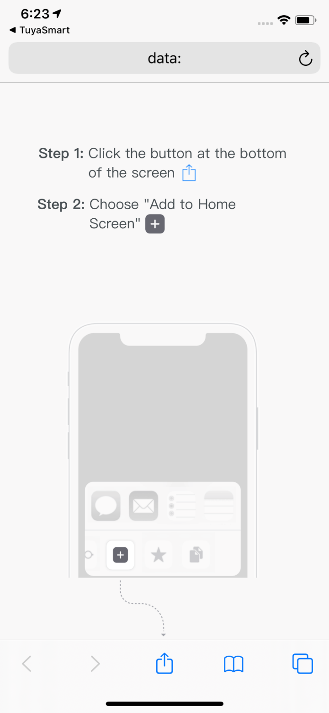
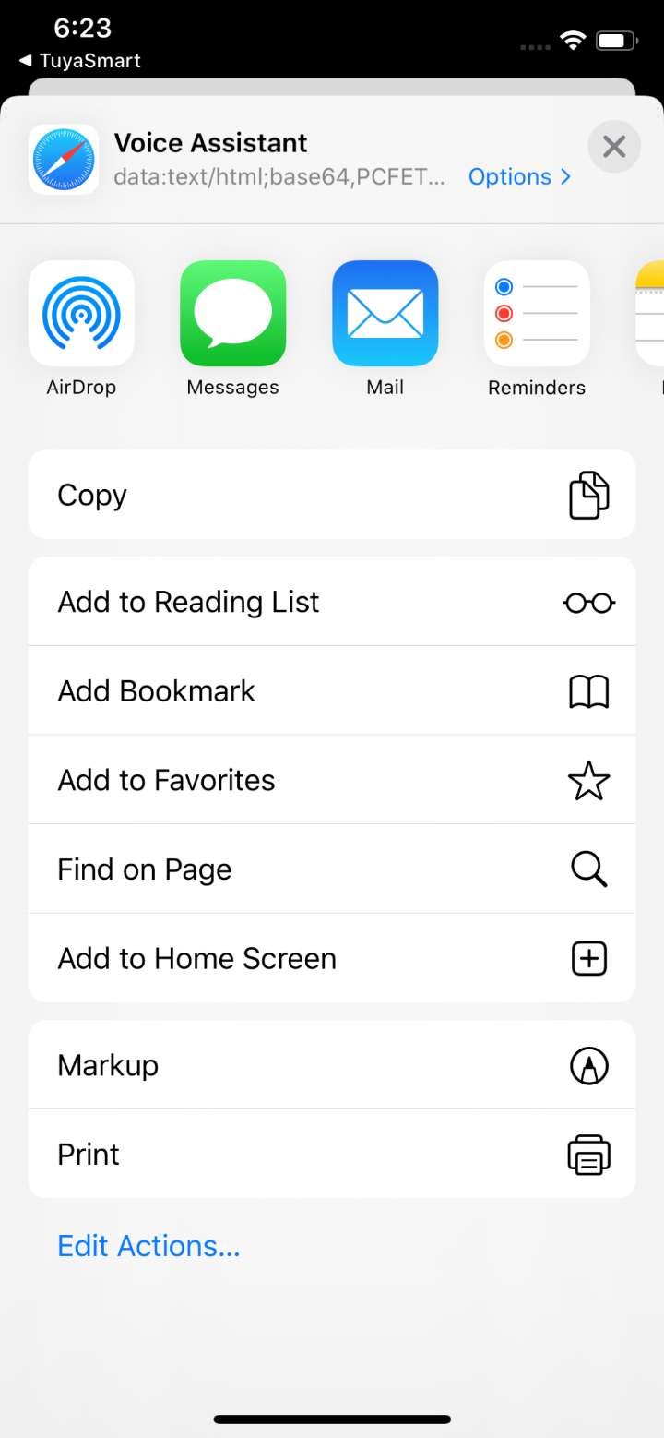
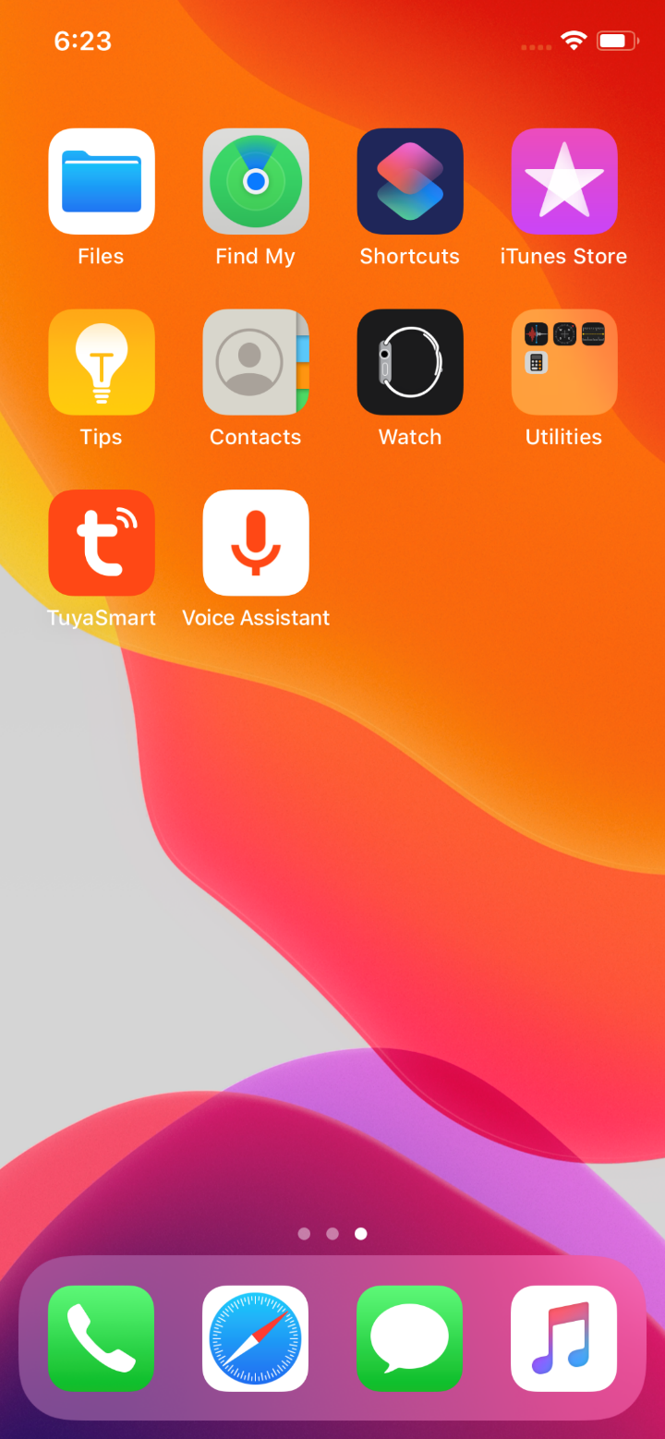
NO.3.2
Voice Assistant
5. You can create Voice Assistant shortcut to the phone home page according to the instructions. （The pictures shown in the left are instructions for iOS user.If you are an android phone user, you only need to enable the access to create shortcut in the home page. ）

Slide 19
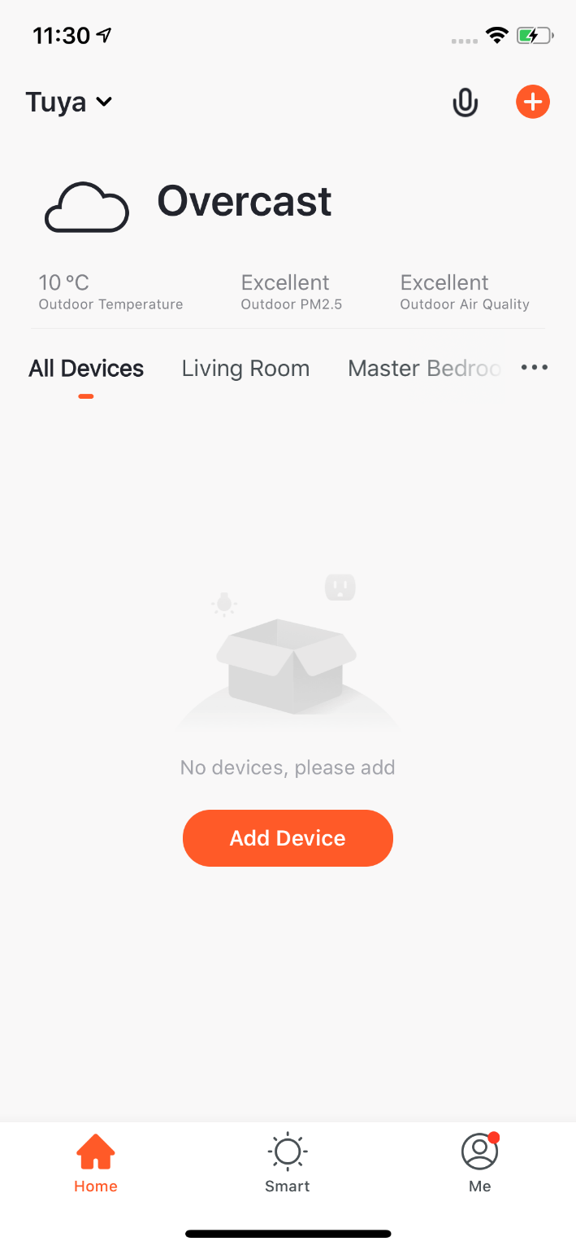
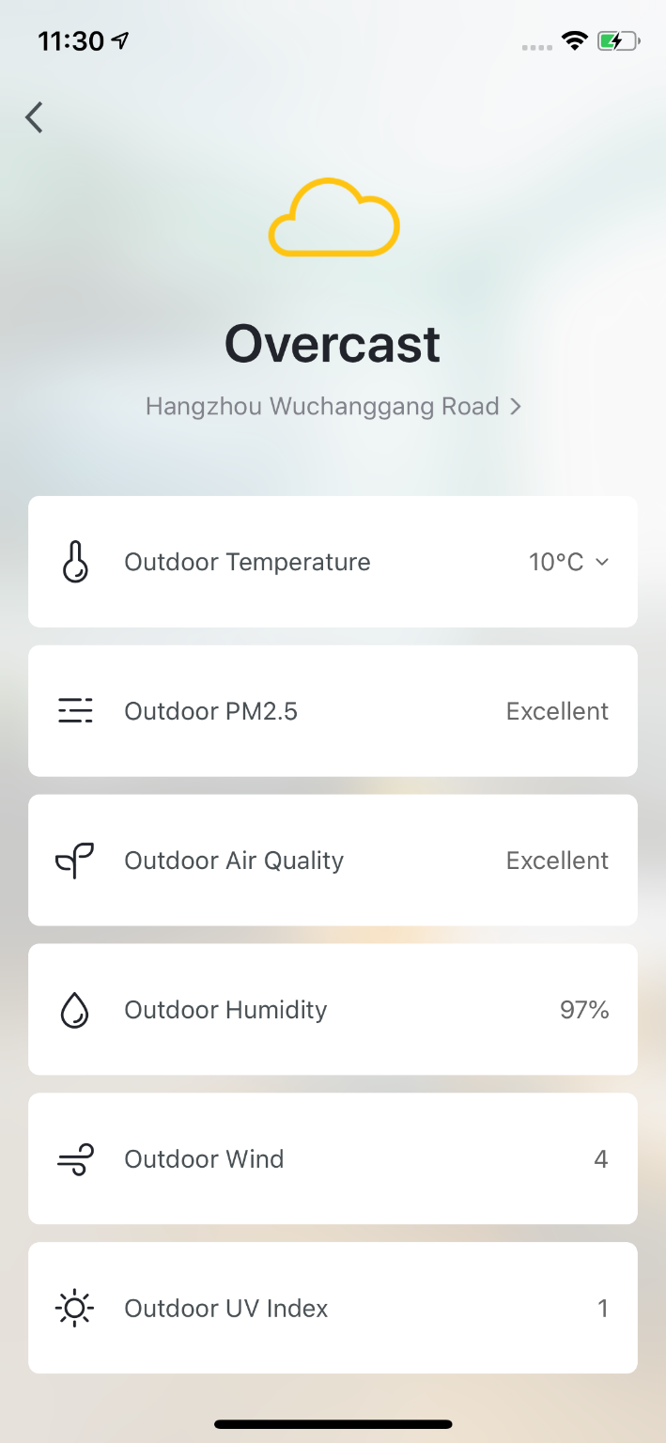
NO.3.3
Environment Information
After you complete the home information and location, you can see weather and environment information in the home page. You can also click it to see more details.
If you have connected sensors devices with the APP(For example:air purifier, thermometer,hygrometer etc),it will show the environment information detected by these devices.
You can press the item and drag the information to adjust the orders.(Only home owners and administrators have the access to control this).

Slide 20
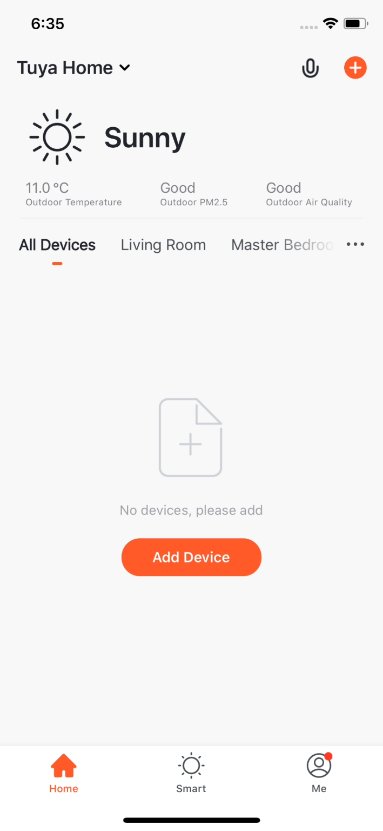
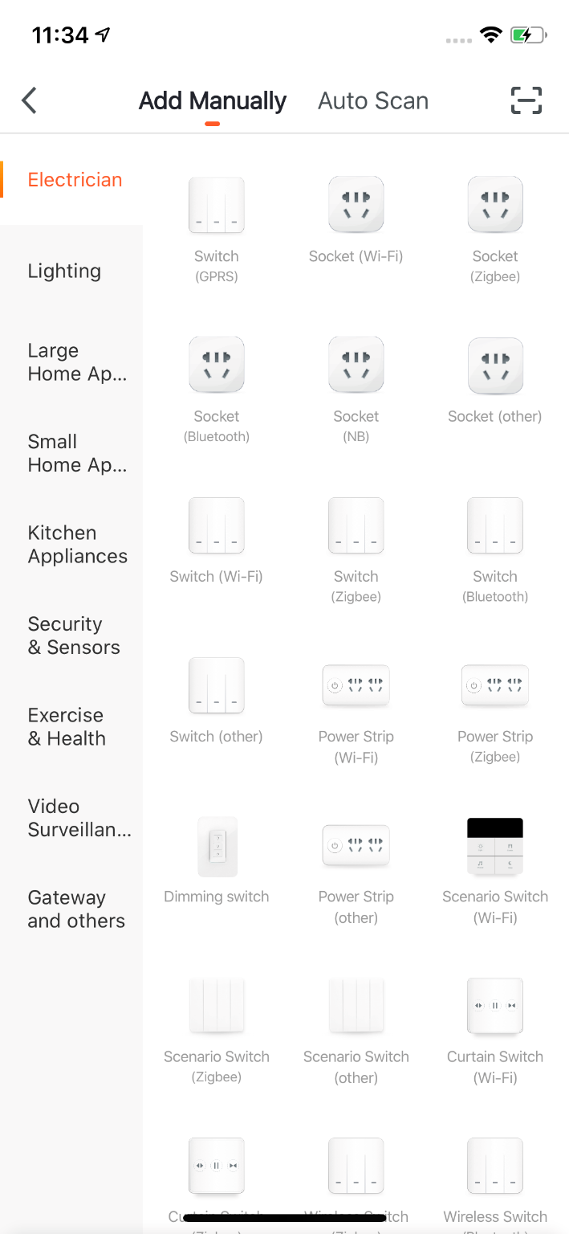
NO.3.4
Add Devices
Click “Add Devices”or “+”in the top right corner to enter add device page. There are two ways of adding devices, which are “Add Manually”and “Auto Scan”.（If you use “Auto Scan”, you need to allow the APP to use Wi-Fi and Bluetooth）

Slide 21
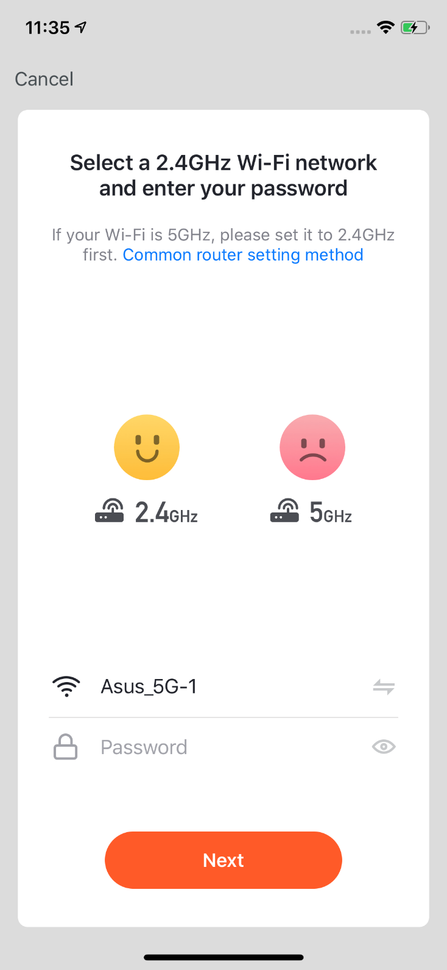
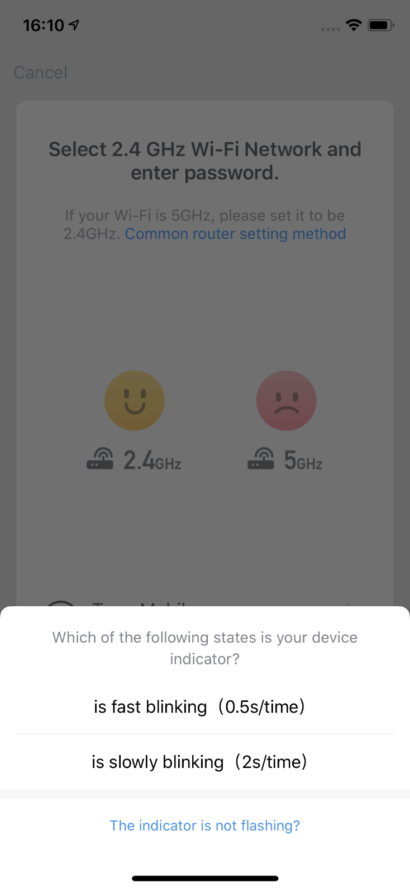
NO.3.4.1
Add Manually- Wi-Fi Devices-Connect to Wi-Fi
1. Firstly，you will turn to the page where you need to enter your Wi-Fi password. （Only 2.4G Wi-Fi can be supported.）
If you already know how to add and reset the device, you can choose the right method according to the status of the indicator. If you are unclear about add and reset device, you can click the “The indicator is not flashing" option to view the guide.

Slide 22
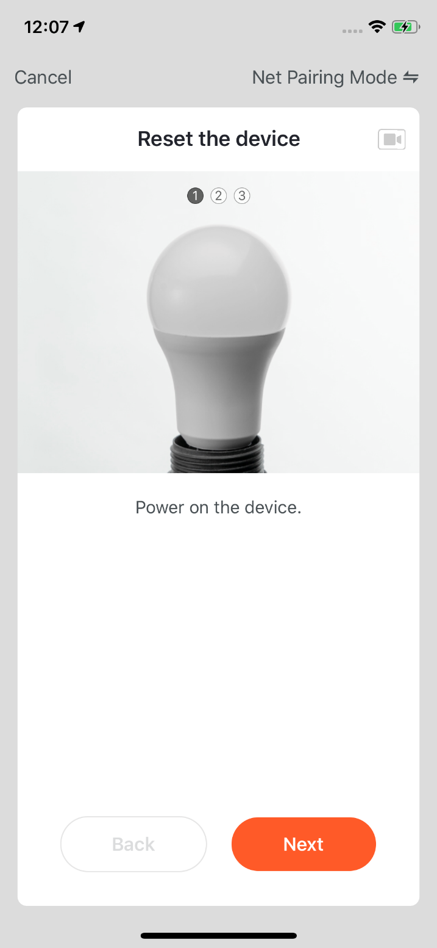
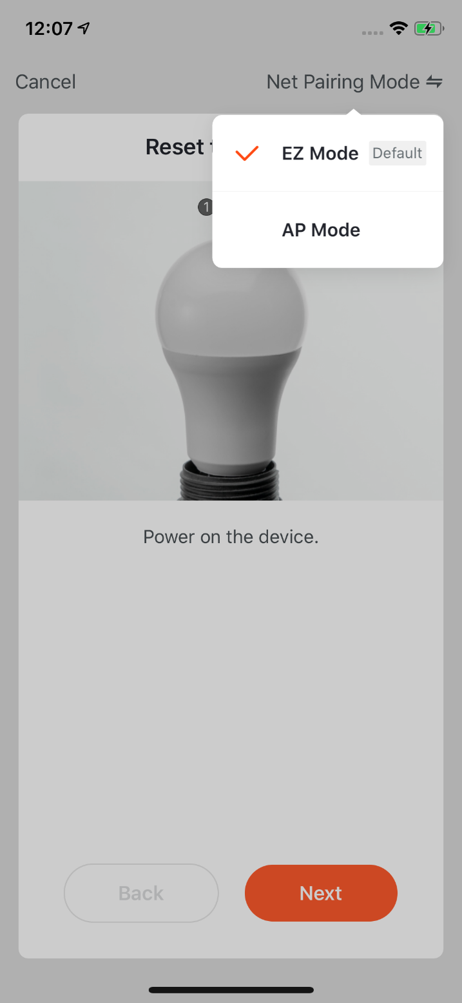
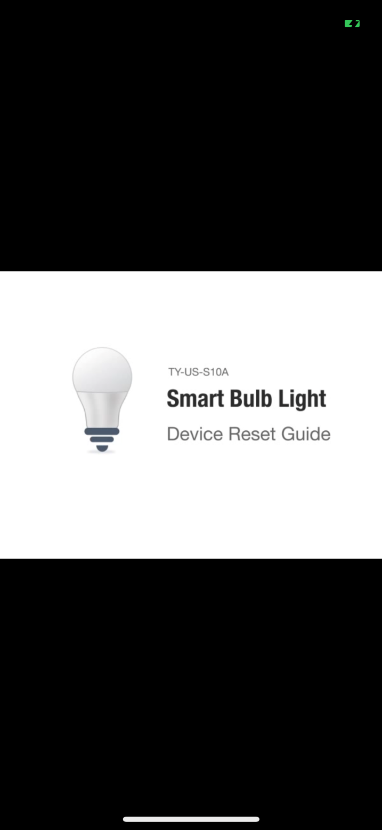
NO.3.4.1
Add Manually-Wi-Fi Devices
2. After click the "The indicator is not flashing" option, it will jump to the guide page. There are two network configuration modes for devices (except IPC devices and NB devices). They are EZ mode and AP mode.
You can switch mode by clicking “Other Mode”in the top right corner.（There is a Guide Video available）

Slide 23
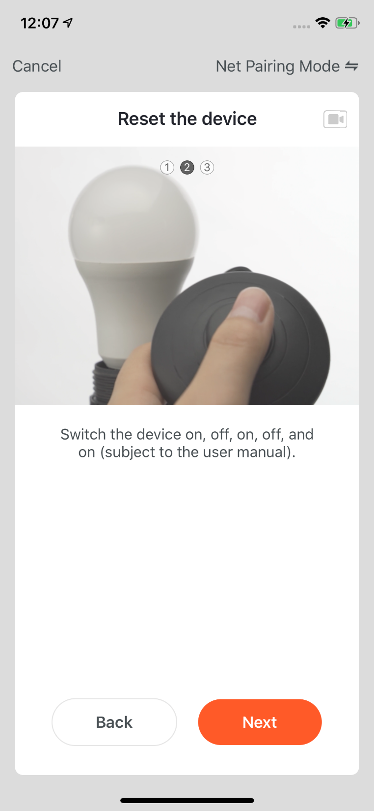
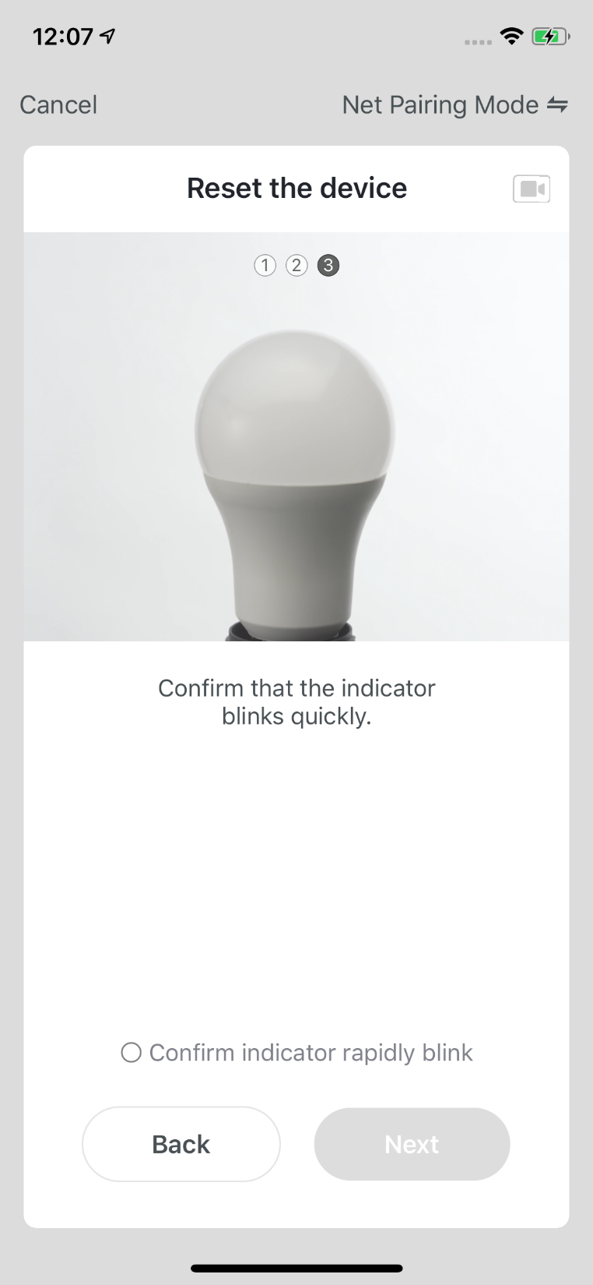
NO.3.4.1
Add Manually- Wi-Fi-EZ Mode
1. If you use EZ Mode to connect devices, you need to follow the three steps and set the indicator light to fast blinking.

Slide 24
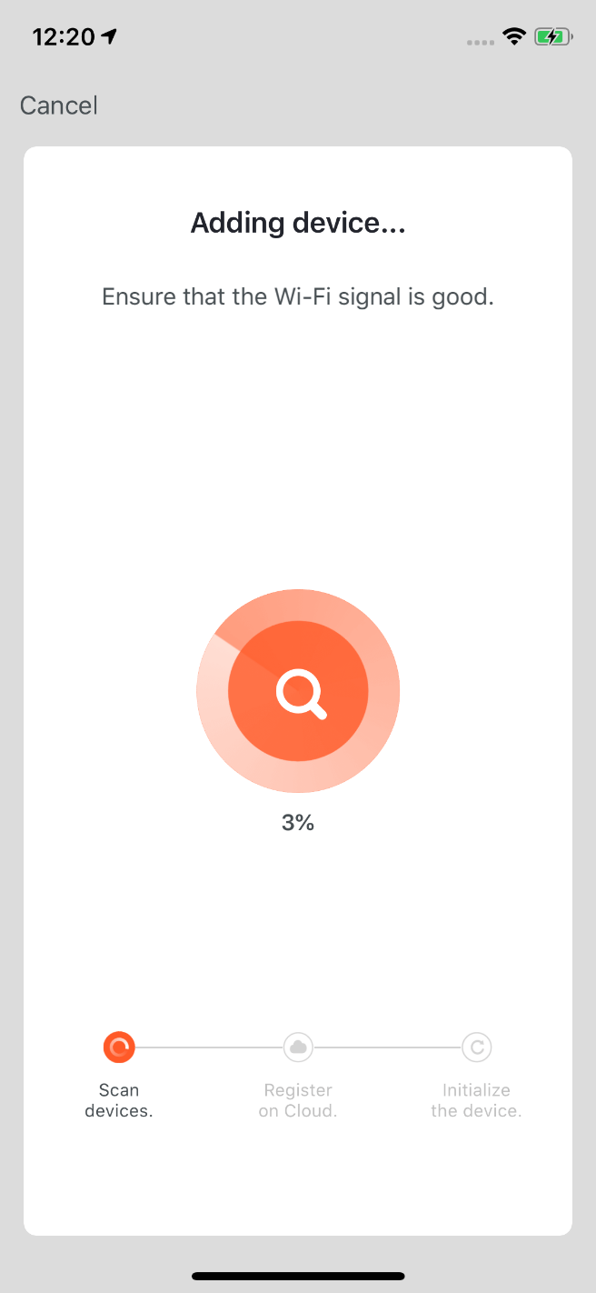
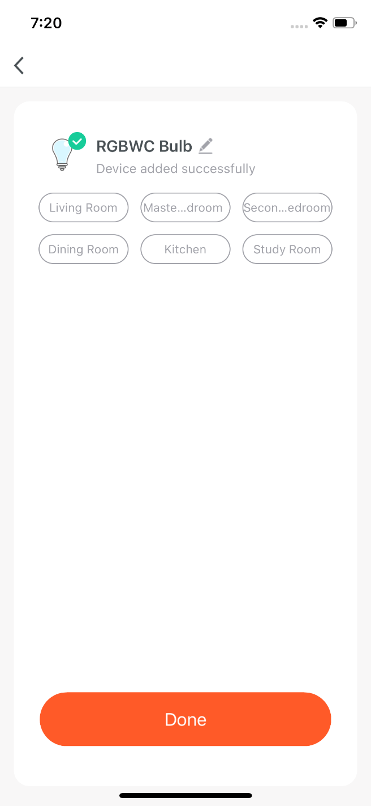
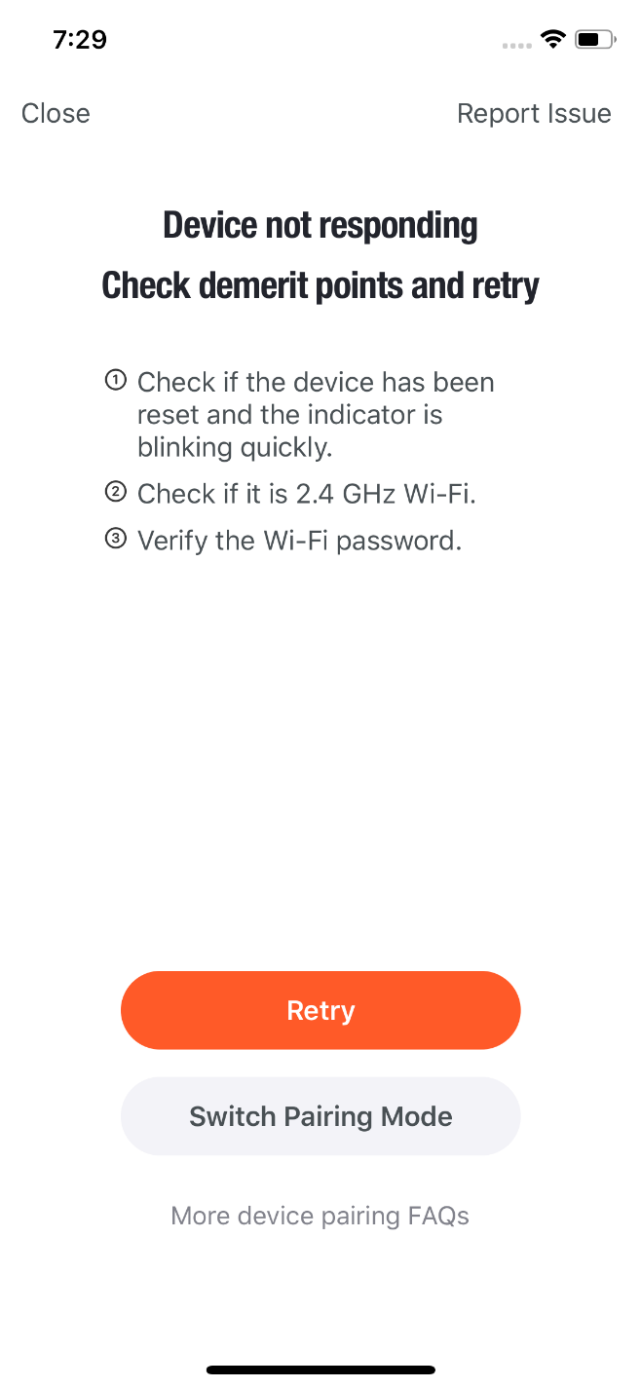
NO.3.4.1
Add Manually - Wi-Fi Devices-Network Configuration
2. If you use EZ mode to connect devices, the process is presented in the first two pictures in the left. You can customize the names of the devices (64 characters maximum) and assign rooms for the devices.
3. If it fails to connect the device, the APP will show the third page in the left. You can follow the instructions to solve the problems.

Slide 25
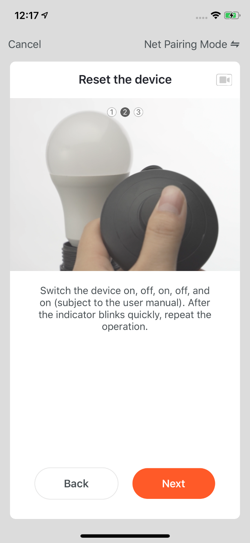
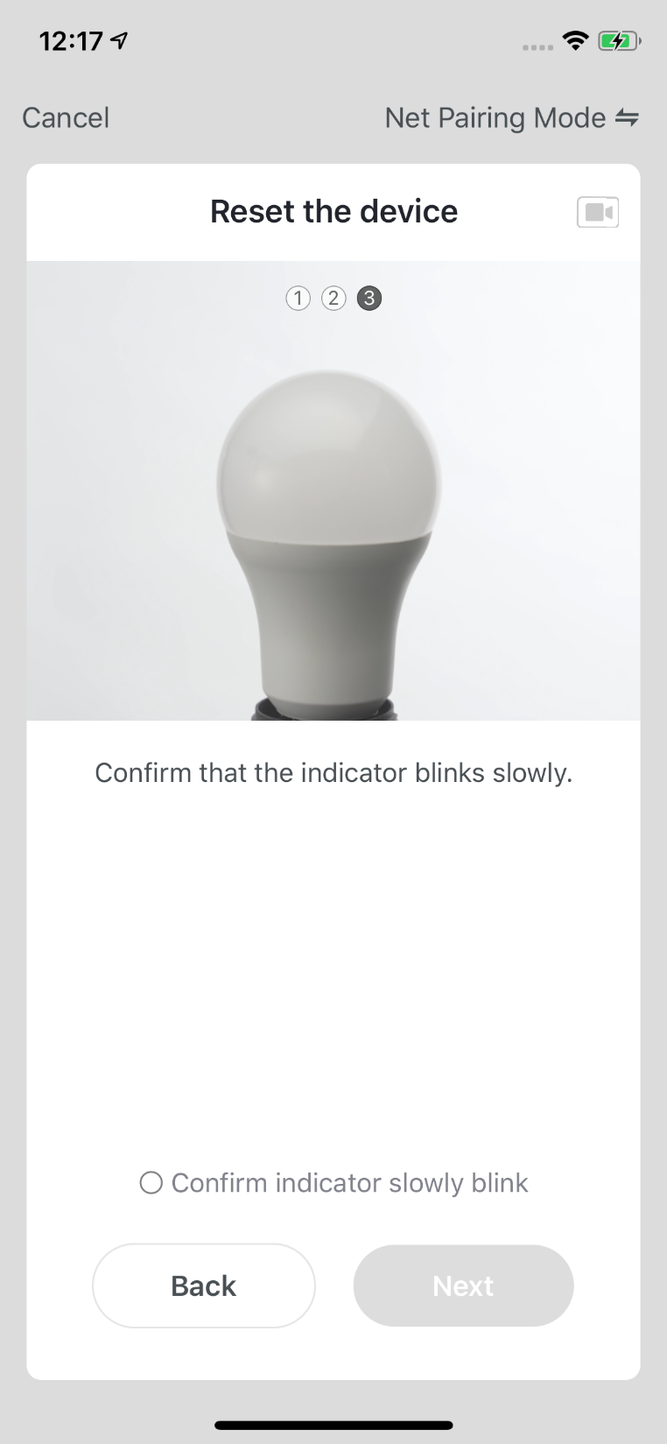
NO.3.4.1
Add Manually- Wi-Fi-AP Mode
1. If the network in your home is 2.4Ghz and 5Ghz mixed, you can use AP mode (compatibility mode).
2. If you use AP mode to connect devices, you need to follow the three steps in the page to set the indicator light to blinking slowly.

Slide 26
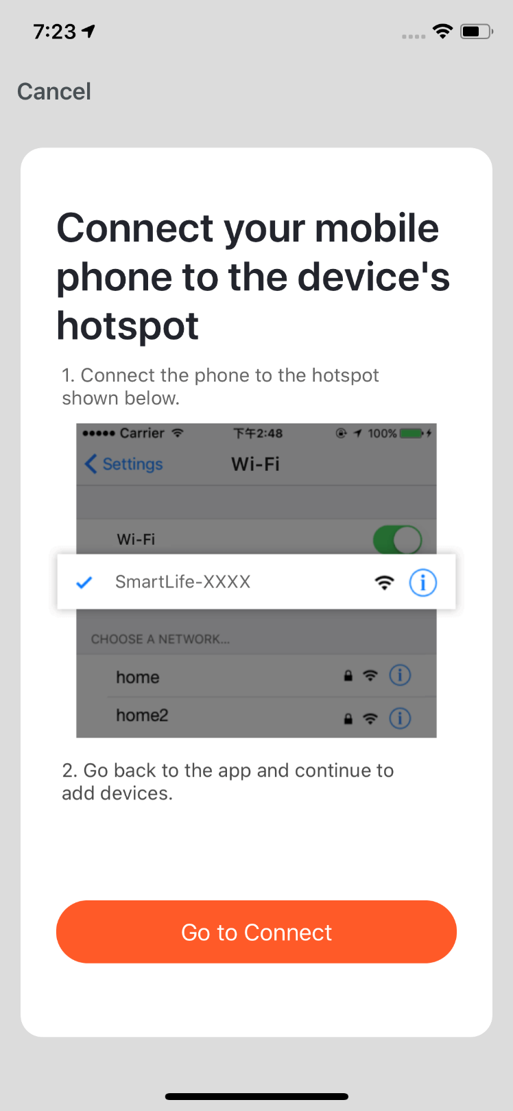
NO.3.4.1
Add Manually-Wi-Fi Devices-Network Configuration
3. If you use AP mode to connect the device, you need to connect your phone to a Wi-Fi that starts with the name “SmartLife”.

Slide 27
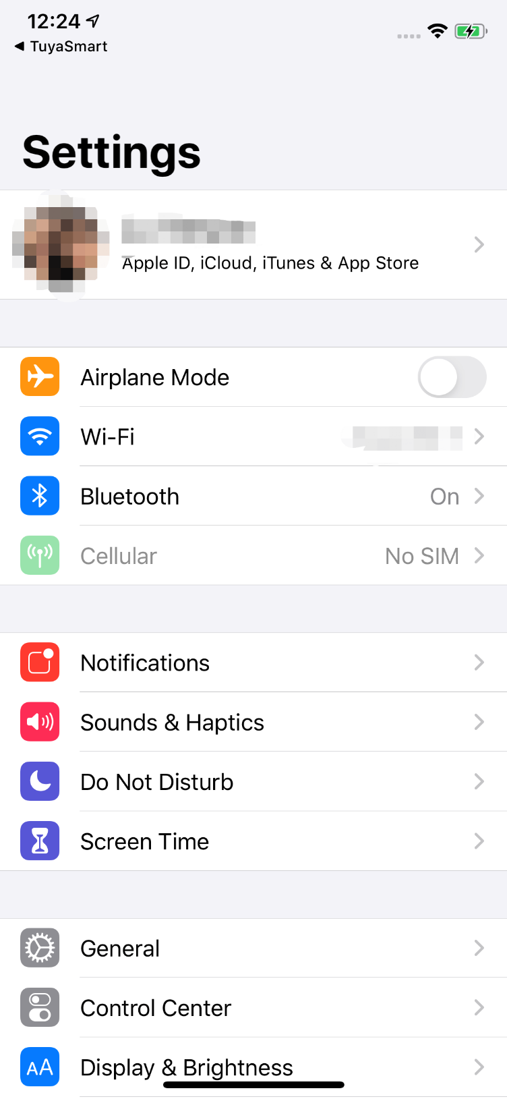
NO.3.4.1
Add Manually-Wi-Fi Devices-Network Configuration
4. Open the Wi-Fi set up page in the phone and find hotspots that starts with “SmartLife”, click it to connect.
5. After successfully connecting to the Wi-Fi, return the the APP and start the network configuration. （The Wi-Fi needs to be 2.4G. Some names of device's hotspots may not neccessarily start with “SmartLife”. It could be customized names.）

Slide 28
NO.3.4.1
Add Manually-Wi-Fi Devices-Network Configuration
6. Connect to the device's hotspot and return to the network configuration page in the APP to continue the process. The page will be shown as the left pictures. After the devices are successfully connected, you can customize the devices' names(64 characters maximum) and assign rooms for the devices.
7. If it fails to connect the device, the APP will show the third page in the left. You can follow the instructions to solve the problems.

Slide 29
NO.3.4.1
Add Manually-Wi-fi bluetooth dual mode network
1. When you use the WiFi and bluetooth membrane dual distribution network product, you can connect the device to the power supply first, and the App home page will automatically pop up the device to be connected. If there are multiple devices to be connected, choose the device you need.

Slide 30
NO.3.4.1
Add Manually-Wi-fi bluetooth dual mode network
2. Connect to the WiFi at home and wait for the device to connect to complete the connection.

Slide 31
NO.3.4.1
Add Manually-Wi-fi bluetooth dual mode network
1. Of course, if you are not willing to use bluetooth connection, you can also choose WiFi connection. First you can select the corresponding device type. To set the indicator light to the flash state, please follow the three steps in the figure to complete the setting.

Slide 32
NO.3.4.1
Add Manually-Wi-fi bluetooth dual mode network
Click to rename
2. After completing the three steps, wait for the device to connect. After successful connection, the device can be renamed and room classification.

Slide 33
NO.3.4.1
Add Manually-Wi-fi bluetooth dual mode network
1. You can also connect the device via bluetooth by clicking the "add device" button in the center of the device list page or clicking the "+" button at the top right.
2. You can enter the "add device" page, select the device you want to add and power the bulb, and reset the device according to the tutorial.

Slide 34
NO.3.4.1
Add Manually-Wi-fi bluetooth dual mode network
3. Wait for the system to search the device and connect the device, and click "complete" after the step.

Slide 35
NO.3.4.1
Add Manually- Wi-Fi-AP Mode
1. If the network in your home is 2.4Ghz and 5Ghz mixed, you can use AP mode (compatibility mode).
2. If you use AP mode to connect devices, you need to follow the three steps in the page to set the indicator light to blinking slowly.

Slide 36
NO.3.4.2
Add Manually--ZigBee Devices
1. You will have to connect gateway first before connecting ZigBee devices. Therefore, please click “Add Manually >> Others”and choose a gateway.
2、Power on the gateway and connect it to the router through.
3. Please make sure the phone and the gateway connects to the same LAN. （The Wi-Fi needs to be 2.4G.）

Slide 37
NO.3.4.2
Add Manually--ZigBee Devices
4. After successfully adding the gateway as instructed, you can then start to connect the relevant ZigBee devices.

Slide 38
NO.3.4.2
Add Manually--ZigBee Devices
5. After adding the gateway, you can turn to the gateway page and click “Add Devices”.You will see other devices that have already connected to this gateway. You can also add them to your account.
6. In the latest APP version, it has “Search devices”function so that you can add more devices to your gateway at the same time.

Slide 39
NO.3.4.3
Add Manually--IPC Devices—Wired Network Configuration
1. Most devices can connect with the APP through Smart Mode (the default mode) and AP Mode. Except these two pairing modes, some devices (such as IPC devices and gateways) also have Wired Network Configuration mode.

Slide 40
NO.3.4.3
Add Manually--IPC Devices—Wired Network Configuration
2. If you use the QR code to configure the network, you need to set the indicator light of the IPC device to a fast flashing state or hear a prompt tone.
3. The reset steps can be viewed by clicking the “Perform net pairing as prompted" button.

Slide 41
NO.3.4.3
Add Manually--IPC Devices—QR Code Distribution Network
4. After clicking “Next”you will be taken to the page for entering the Wi-Fi password.
5. Follow the prompts on the page, please scan the QR code from 15to 20cm away.
6. If you heard a prompt, please click “I heard a prompt”to the next stage.
7. If the network configuration fails, the following page will be displayed.

Slide 42
NO.3.4.4
Search Device
1. You can search the following devices through Auto Scan, which include Wi-Fi devices, bluetooth gateway devices, bluetooth Mesh devices, Zigbee gateway devices and other Zigbee devices that have connected to your gateway. You can add all these devices in one click.
2. If the search times out and no devices are found, please follow the instructions to solve the problems. Or you can choose to add them manually.

Slide 43
NO.3.4.4
Search Device—Request for Permission
3. When using “Auto Scan”, you need to enable Wi-Fi and Bluetooth of the phone. If you do not enable Wi-Fi, Wi-Fi device will not be searched; If you do not enable Bluetooth, Bluetooth devices that nearby your phone will not be searched.

Slide 44
NO.3.4.4
Search Device—Request for Permission
4. The app is now enabled to automatically scan nearby Bluetooth devices, which improves its functionality with Bluetooth devices.
5. Open the App and go to “Home”. The app will automatically search for Bluetooth devices that are in pairing mode. After the devices are found, they will be shown in the home page (like the photo on the left).
6. You can click “Do not add” or “Go to add” to choose whether to add these Bluetooth devices or not. (When searching for Bluetooth devices, Bluetooth permission from the app is required and the devices need to be in pairing mode)

Slide 45
NO.3.4.4
Search Device—EZ mode that Supports Add Devices Manually
7. You can also set NB-IoT Wi-Fi products to quickly flash and use Auto Scan to connect them in one click. (Please use 2.4G Wi-Fi. Also Wi-Fi name and password needs to be entered in the APP.)

Slide 46
NO.3.4.5
Scan to Pair Devices ：Scan QR code in NB Products or Enter Code
Choose the NB products you want to connect and click the scan icon on the top upper right corner to scan the device's QR code. Or you can directly enter the IMEI number on the device's label and choose “Confirm”to connect the devices with the APP.(The APP will need phone camera access when scanning.)

Slide 47
NO.3.4.5
Added the distribution method of scanning code distribution network
According to the demand, the IoT platform-product management can be added to the scan code distribution network. Just scan the QR code on the product or the outer packaging of the product to jump directly to the distribution page.

Slide 48
NO.3.4.6
Android Permissions Open Guide
Android mobile phones will trigger push reach detection when security devices are added. If a pop-up window is displayed, click "Detect" and then click "Next" to check the corresponding detection tutorial against your mobile phone model to complete the relevant push reach detection.

Slide 49
NO.3.5
Device/Room List
Device Page：You can see all the devices, room names in this page.
Click “···”in the right, you can choose to see devices in list view or gird view; You can click “Equipment management”to manage the devices order; You can edit rooms through “Room Management”.

Slide 50
NO.3.5.1
Device management
1. To change the sequence of devices, click “...” on Home page, then click “Device Sequence”. Now you can drag “≡” to adjust the order of your devices. Multi-select devices can be batch deleted device management.
50

Slide 51
NO.3.5.1
Room Sequence
2. To manage your rooms, click “...” on Home page, and choose “Room Management”, then click the icon appears on the top-right corner of the screen. Now you can drag “≡” to adjust the order of your rooms and click “-” to delete the room.
51

Slide 52
NO.3.5.2
Device/Room List
3. Device Online/Offline: the module is dark if the device is offline, and bright if the device is online;
4. Some devices will have important data information shown on the Home page. For example, the devices with temperature, like air conditioning, water heater, heating, etc. When the device is open, the temperature data will be directly shown on the device icon with no need to click on it.

Slide 53
NO.3.5.3
Quick Actions for Common Functions
1. In Grid View, click the small arrow on the bottom right corner of the device icon to open more common functions, like the switch bottom and temperature adjustment for air conditioning.

Slide 54
NO.3.5.3
Quick Actions for Common Functions
2. In List View, click “Common Functions” on the bottom of device icon to open more device functions, like the switch bottom and temperature adjustment for air conditioning.

Slide 55
NO.3.5.3
Quick Actions for Common Functions
3. When there are more than two “Smart Cameras” in the list, the option of “All Cameras” will appear on the homepage. After you click to enter, you can view the video multiple cameras in one screen.

Slide 56
NO.4
Device Control
1. A device icon will appear in “All Devices” when the device completes pairing successfully. Now you can click on the icon to enter he control panel of this smart device. (The control panel will vary fron device to device)
2. When the device is offline, the icon will show “Offline” and the device is unable to operate.

Slide 57
NO.4.1
Device Control-Individual Control
3. Click the device icon to enter the control panel. Take the light as an example. When the light is off, you can only set “Schedule” and “Timer”; when the light is on, you can set “Scene, Color, Brightness and Schedule”. Click "✏" in the upper right corner of the control panel to manage this device separately.

Slide 58
NO.4.1
Device Control-Device Management
Please see the device editing page, as shown in the image:
1. Click the icon: you can edit the icon, name and location;
2. Device Information: you can view the device's ID, IP address, MAC address, time zone, and online status, etc.;
3. Tap-to-Run and Automation: you can turn on/off or edit the recommended Automoation setting;
4. Share Device: you can share devices with others by entering an phone number/email (Notes: the phone number/email must have registered for TuyaSmart);
5. Create Group: after entering the page, all devices with the same type as this device that have been added under this account will be automatically displayed. By creating group for them, you can easily manage the devices with the same type (Built-in firmwares must have the same version)；
6. FAQ & Feedback: you can view the FAQ of this device to get help, and also give feedback if you have any problems;
7. Add to Home Screen: you can enter the control panel of the device directly through your Home Screen;
8. Check for Firmware Upgrade: you can check latest version here;
9. Remove Devcie: you can remove the device from device list, and the corresponding “Automation” and “Tap-to-Run” will be removed too;
10. Restore Factory Defaults: the device will be removed from device list, and all data of the device will be erased.

Slide 59
NO.4.1
Device Control-Device Sharing
1. Click "Device Sharing" on the "Device Management" page to enter the device sharing page.
2. After entering the "Device Sharing" page, click "Add Sharing" at the bottom of the page, and enter the account. (People you share with should also have a TuyaSmart account, and in the same region as you; accounts in different regions do not support device sharing.)
3. If you do not want to continue sharing, you can delete the shared account by long press in Andriod system, and by swiping left in Apple system.

Slide 60
NO.4.2
Device Control-Group Control
Click "Create Group" on the device editing page.
The page will show the devices with the same type that can be created into one group. After selecting the devices, click “Confirm”, then enter the group name, and click “Save” to complete.
After the group is successfully created, it will automatically jump to the group control panel. You can now control these devices in a group.

Slide 61
NO.4.2
Device Control-Group Control
4. The group will be shown in “All Devices" after being created, and you can easily control it thourgh Home page;
5. After entering the group control panel, you can click “✏” in the upper right corner to edit the group information, and to delete this group by clicking “Dismiss Group”.
图1
图2
图3

Slide 62
NO.5
Smart-Automation
1. Under "Automation" in the "Smart" page, click "Add Automation" or "+" on the upper right corner to enter the "Smart Settings" page.
2. By clicking "Add Condition". you can add multiple conditions (you can not add other conditions with "Click to execute"), and multiple tasks (you can also select a "Tap-To-Run"). Then, you can edit the name of this automation and set a effective period for it.

Slide 63
NO.5
Smart-Automation
1. After adding “Automation”, you will see a page called “Create Smart”that will guide you through the setting.
2. You need to set up conditions that will be used later to trigger the scenario. Here, we take “Weather change”setting as an example.
3. After you click”Weather change”, you need to set up conditions in more specific terms. Here we choose “Temperature”as an example.
4. After you choose the temperature you want, click “Next” to save the setting and go to the next step.

Slide 64
NO.5
Smart-Automation
5. After the conditions are set, the app will turn to page for setting up tasks.
6. Here we choose “Execution Equipment”as an example, which means choosing an equipment for executing the tasks.
7. Here we choose the air conditioning as an exmaple.
8. After choosing the device, you can set up multiple “functions”for it. For instance, we choose “Switch: On, Set Temp: 26℃, Mode: Cold, Wind: High”, which means that when the conditions we set are met, these functions will be on. Then click “Next”to save and go to the next step.

Slide 65
NO.5
Smart-Automation
1. After adding “Automation”, you will see a page called “Create Smart”that will guide you through the setting.
2. You need to set up conditions that will be used later to trigger the scenario. Here, we take “Weather change”setting as an example.
3. After you click”Weather change”, you need to set up conditions in more specific terms. Here we choose “Sunset/Sunrise”as an example.
4. The execution conditions can be selected from sunrise or sunset, and the time period before and after sunrise or sunset can also be selected. After selecting the execution time and go to the next step.

Slide 66
NO.5
Smart-Automation
5. After the conditions are set, the app will turn to page for setting up tasks.
6. Here we choose “Execution Equipment”as an example, which means choosing an equipment for executing the tasks.
7. Here we choose the air conditioning as an exmaple.
8. After choosing the device, you can set up multiple “functions”for it. For instance, we choose “Switch: On, Set Temp: 26℃, Mode: Cold, Wind: High”, which means that when the conditions we set are met, these functions will be on. Then click “Next”to save and go to the next step.

Slide 67
NO.5
Smart-Automation
9. Set “Condition” and “Task” to save.
10. Click “+” on the upper right corner to add multiple conditions.
11. Select effective period at bottom of the page for your “Automation”. Here, we choose “19:00 - 3:00” to avoid air conditioning being turned on during working hours when nobody is home.

Slide 68
NO.5
Smart-Automation
1. App will recommend some “Automation” and “Tap-to-Run” based on your devices, which you can use directly.
2. Click “Create from template” at bottom of the “Create Smart” page to get some recommended “Automoations”.

Slide 69
NO.5.1
Smart-Automation-Add Condition
1. Take “Leave or Arrive” as an example, you can set some certain actions to be triggered when you are leaving or arriving. (To use this function, you need to allow the App to access your location. The function is currently unavailable in Android version.)
2. Click “Leave or Arrive”, and select your location, then click “Next” to finish setting. This setting will enable you to control your devices and to executive your tasks within 110-1023 meters from your location.

Slide 70
NO.5.1
Smart-Automation-Add Task
1. Click “Add Task” or “+” on the upper right corner to enter the “Select Task” page.
2. This “Task” can be a device switch under a certain condition or an automation execution.
3. The tasks include: “Launch Tap to Run”, “Enable or Disable Automation”, “Send notification”. “Time to left” and “Device”.

Slide 71
NO.5.1
Smart-Automation-Effective Period
1. You can select the effective period to the automation you set.
2. For example, if you want to set an automation, where the night light will turn on when the sensor detects any human action, you can select Night for Effective Period so that the automation will be off in the daytime.

Slide 72
NO.5.1
Smart-Automation-Examples
The completed automation setting of condition and task is shown in the image.
There are mainly 4 types of automation can be achieved:
1、Linkage among devices: you can set that aroma diffuser and air purifier to be turned on while air conditioning is on;
2、Linakge between environment and device: you can set to automaticlly turn on the air conditioning while the temperature is over 29℃;
3、Timer: to automaticlly open the curtain at 8am on every morning;
4、Location: to trigger some actions when someone leaves or arrvies somewhere. For examle, to open the air conditioing and water heater when you are nearby your home.

Slide 73
NO.5.1
Smart-Automation-Push messages support multiple selection
1.Click "create a new account", the graffiti will pop up and click "smart - add - send notification reminder" to enter the "select reminder mode" page. This page feature supports multiple selections (at least 1, and at most 3). If the phone notification and SMS reminder are not purchased, you can only choose the message center.
2. After completing the configuration, return to the home page of automation, which can be combined according to the selected push mode.

Slide 74
NO.5.2
Smart-Scene
1. Under “Tap-To-Run” in “Smart” page, click “Add Tap-To-Run” or “+” on the upper right corner to enter the setting page.
2. You must choose “Click to execute” as a condition.
3. You can not add “Luach Tap to Run” or “Send Notification” as a task.

Slide 75
NO.5.2
Smart-Scene
4. When choose “Enable or Disabele Automation” as a task, you need to pre-set an “Automation” scene.
5. After clicking “Enable or Disabele Automation”, the existed automation will be shown on the screen. Select to choose “Enable” or “Disable” it and click “Next”. Last, click “Save” and enter your scenario name to complete setting. (“Effective Period” is unavailable for “Tap-to-Run”)

Slide 76
NO.5.2
Smart-Scene
“Automation” supports gateway for Tap to Run of local scenario
New ZigBee gateway supports “Automation” Tap to Run of local scenario, that is if all the tasks of an “Automation” and the device are under new ZigBee gateway, the “Automation” can be executived in offline mode. Even if your network is offline, the devices and tasks bound under new ZigBee gateway will still execute the automation that you have set before.

Slide 77
NO.5.2
Smart-Scene-Zigbee gateway linkage data backup and recovery
The App now supports the function of "Zigbee gateway linkage data backup and recovery". This means that even if the zigbee gateway in the user's home is removed, the previous linkage scene information will be automatically retained, and the linkage scene information will be restored after the device is reconfigured in the user's home (normal configuration, automatic discovery).

Slide 78
NO.5.3
Smart-Add/Edit/Delete
1. The ”Tap-to-Run” and “Automation” that you have set will be shown on the “Smart” page. By clicking “...” on the upper right corner, you will be able to edit or change the order for them.
2. Click to enter the editing page, and you can change the order or swipe left to delete your scenario or automation. (for Apple system, click “-” to delete)

Slide 79
NO.5.3
Smart-Add/Edit/Delete
3. Click “...” on upper right corner of your “Tap-to-Run” or “Automation” to enter the editing page.
4. Swipe left to delete any “Condition” or “Task”.
5. Click “+” to add new “Condition” and “Task”.
6. Click “Delete” at bottom of the page to remove the entire “Tap-to-Run” or “Automation”.
7. By clicking your “Automation”, you can choose to edit or remove it directly.

Slide 80
NO.5.3
Smart-Add/Edit/Delete
Click “Add to Siri” on the bottom right corner of the “Smart” page to enter the “Siri Shortcut” page.
You can add any “Tap-to-Run” to Siri
On the “Add to Siri” page, you can set custom phrase for Siri to trigger your “Tap-to-Run”（This function is only available for iOS system over 12.0 version）

Slide 81
NO.5.3
Smart-Scene logs
1.Click the log display interface to view the scene log in reverse chronological order.
2. Store log information for up to 7 days intelligently.
3. Click a specific log to jump to the corresponding scene editing page.
4. If a device fails to execute during automated execution, an alarm message will be pushed in the notification center and the execution failure log will be kept, through which the specific execution failed device can be viewed.

Slide 82
NO.5.4
Scenario Execuation in LAN
The new function “Scenario execuation in LAN” has been added. With the LAN, all the tasks of the scenario can be executed without Internet. LAN will control the devices depending on the order of the device actions.

Slide 83
NO.6
My Home
2
4
Voice Control
Switch/Add Home
Click to set the weather. You can change the order of the information, and the top 3 will be shown on the home page.
Add different types of Smart devices
Click your ”Tap-to-Run” to chnage your living scenarios quickly
Switch your rooms to check your devices in different rooms
1
3
5
6

Slide 84
NO.7
“Me”
1. Home Management: manage your home and home members; 2. Watch: this will be shown only if your iPhone has bound Apple Watch. You can control your devices and execute “Tap-to-Run” by Apple Watch;
3. Message Center: it includes three types of messgae, Alarm, Home, and Bulletin, where you can select different Do-Not-Disturb Schedules for them;
4. FAQ & Feedback: it includes All Questions, Network Diagnosis, Report Issue, FAQ, and My feedback.
5. More Services: it includes AI Filtered Notification, Cloud Storage for Cameras, Phone Notification, and 8 thrid-party access services.
6. Settings: it includes Sound, App Notification, About, Network Diagnosis, Upload Log, Clear Cache and Log Out (Upload Log is only available in iOS system)

Slide 85
NO.7.1
“Me”—Watch
1. Click “Watch” on “Me” page to enter the “Watch” operation page.
2. Click “Device” too show all your Smart devices. You can add devices by clicking “+”. Some devices are not supported by Watch.
3. Click “Avaliable Tap-To-Run” too add your “Tap-To-Run”
4. All the notification in “Message Center” will also send to Watch.

Slide 86
NO.7.2
“Me”—App Notification Settings
1. There are two ways of notification setting: the first, Me - Settings - App Notification

Slide 87
NO.7.2
“Me”—App Notification Settings
2. The second, Me - Message Center, and then click the gear icon on the upper right corner

Slide 88
NO.7.2
“Me”—App Notification Settings
3. Turn off the notifications to unable any messages, including Alarm, Home, and Bulletin, where you can set them separetly when you enable notificatinos.

Slide 89
NO.7.3
“Me”—Message Center
1.“Alarm” includes device alarm, automation notification, alarm, fail to do device timing;
2. “Home” includes: adding/removing home members, deleting home, setting one member as administrator, adding devices, sharing devices, etc;
3. “Bulletin” includes feedback from users, offical notification, etc.

Slide 90
NO.7.3
“Me”—Message Center
4. Message Center enables you to set Do-Not-Disturb in a specific period.
5. Click “Do-Not-Disturb Schedule” to set the period you want. Please select a Do-Not-Disturb device first before you set a time.

Slide 91
NO.7.3
“Me”—Message Center
6. Click “<” to complete setting and return to the schedule setting page after selecting the devices.
7. Click “Add schedule” to add more “Do-Not-Disturb Schedule”.

Slide 92
NO.7.4
“Me”—FAQ & Feedback
1. Click “Me - FAQ & Feedback” to enter the help center. You can search questions or send any feedback to us here,
2. My feedback: you can check your feedback here.
3. FAQ: you can access frequntly asked questions while using TuyaSmart.
4. All: you can choose any device to see related FAQ, or select “Device networking issues”, “APP use issues”, amd “Third-party control issues” for corresponding FAQ.
5. Netwok Diagnosis: it helps us to solve your problems faster, and the process may take about 2 minutes.
6. Report Issue: please submit your questions, contact information, and image here if you have any problems while using TuyaSmart.

Slide 93
NO.7.5
“Me”—More Services
1. Click “Me - More Services” to find more services includes:
(1) AI Filtered Notificincluding third-party access service.
2. Featured services mainly ation: report any images uploaded by camera; (To get this service, please add Smart camera)
(2) Cloud Storage for Cameras: after purchasing this service, users can watch history videos uploaded by devices to the server; (To get this service, please add Smart camera; the history video can not be download)
(3) Phone Notification: to keep your family safty, you will receive a phone call once the notification conditions has been triggered. (The phone number will be the one you used for registration. If you use an email to register, please set a phone number to receive phone notification.)
2. Third-party Access Service: please click to see how to connect and use.

Slide 94
NO.7.6
“Me”—Settings— About
To improve user experience of thrid-party access service, the app is now able to link to thrid-party virtual assistant with verification code.

Slide 95
NO.7.6
“Me”—Settings— About
1. Click “Me - Settings - About” to find more information about this APP.
2. Click “Rate Us” to rate us through App Store.
3. Click “About TuyaSmart” to find more TuyaSmart information through Tuya website.
4.Click “Privacy Policy” to view Tuya Mobile Privay Policy.
5. Click “User Agreement” to view Service Agreement of Tuya Smart Platform.
5.Click “Open Source Component License” to view all the open licenses list.
6. Check current version of this APP.

Slide 96
NO.8
Personal Center
1. Click “Me - Profile” to enter Personal Center to edit your photo, nickname, temperature unit and time zone here.
2. Click “Account and Security” to change your password or pattern lock, and to deactivate your account.

Slide 97
NO.8.1
Account and Security-Account Deactivation
Click “Me - Profile - Account and Security”.
Click “Deactivate Account” at the bottom of the page. Once you confirmed, your account will be permanently deleted after 7 days and all data will be removed.
The deactivation will fail if you re-login the account before the process done.

Slide 98
NO.8.2
Personal Center-Pattern Lock
1. Click “Pattern Lock” to set a pattern to login.
2. Click “Forgot Pattern Lock” if you forgot it. APP will send you a verification code to reset your pattern.

Slide 99
Thank You
注：
本文配图均为IOS版应用界面，Android 版与此会有细微差异
产品及软件在不断升级中，文本列出的数据及软件界面仅用于说明，如有变化恕不另行通知

